Slide 1
Statistics and R short course Session 5: Basic regression modelling
Jessie Khaki and Marc Henrion

Slide 2

Preliminaries
Course website / GitHub:
https://github.com/mlw-stats/R_And_Statistics_Training_2026
Office hours
Vester - Mondays @ 2pm; Kapeni Meeting 1
Jessie - Mondays @ 3pm; Kapeni Hurdle 1 (Not available today)
Eva - Tuesdays @ 2pm; Creator Ground Floor
Marc - Thursdays @ 9am; Kapeni Meeting 2
Housekeeping
Refreshments (no lunch - sorry)
Fire exits & bathrooms

Slide 3

Preliminaries
https://github.com/mlw-stats/R_And_Statistics_Training_2026

Slide 4
Learning outcomes
EXPLAIN GLMs: able to explain what a GLM is.
UNDERSTAND THE USE OF GLMs: able to explain what a GLM is being used for.
KNOW WHEN AND HOW TO USE A GLM: able to recognise when and how to use a GLM.
FIT GLMs: able to fit a GLM to real-world data.
EXPLAIN VARIABLE AND FUNCTIONAL FORM SELECTION: able to list and explain the different ways to select variables and their functional forms and discuss their limitations.
DIAGNOSE FITTED GLMs: able to diagnose issues with a fitted GLM and able to fit a more appropriate model if needed.

Slide 5
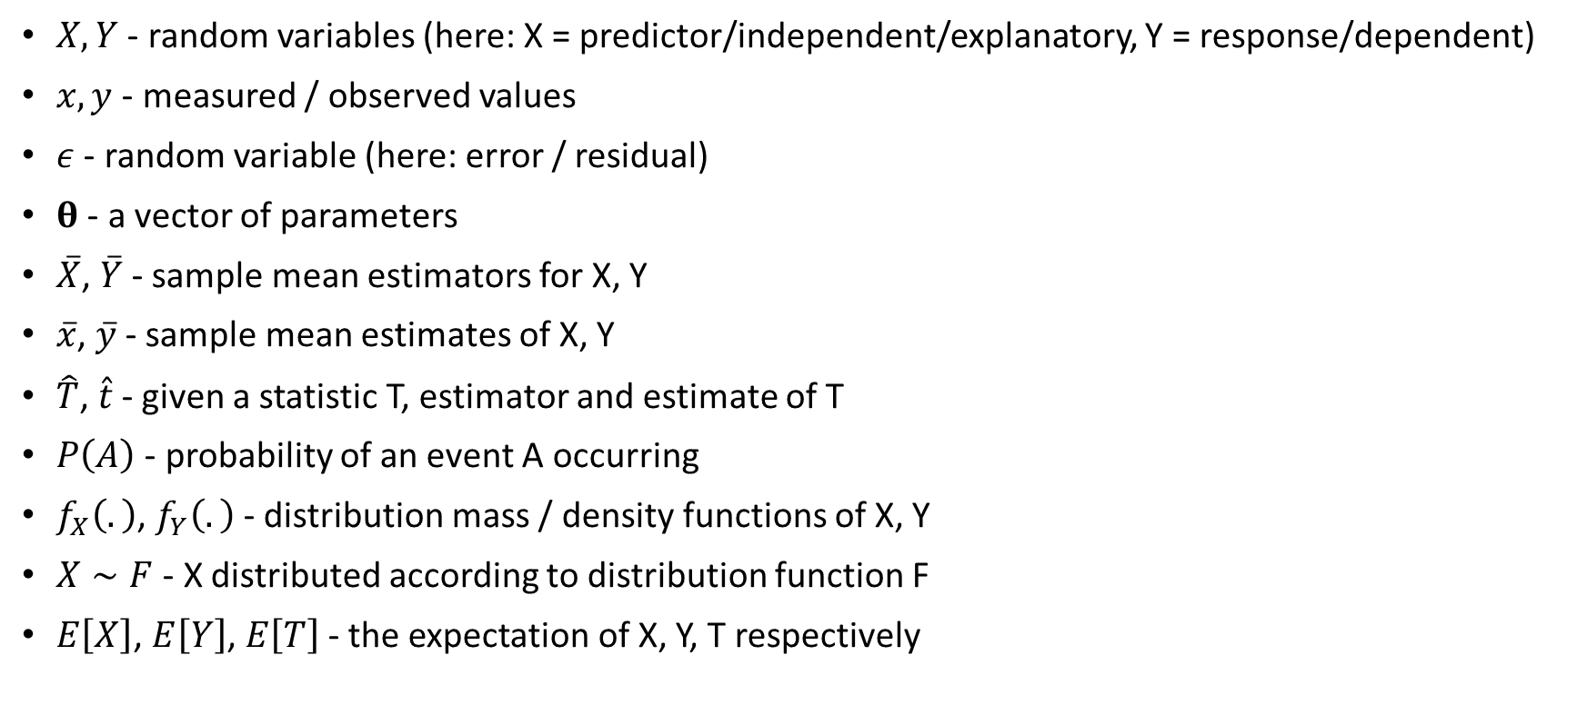
Notation
$X,Y$ - random variables (here: X = predictor/independent/explanatory, Y = response/dependent)
$x,y$ - measured / observed values
$ε$ - random variable (here: error / residual)
$θ$ - a vector of parameters
$\overset{‾}{X}$, $\overset{‾}{Y}$ - sample mean estimators for X, Y
$\overset{‾}{x}$, $\overset{‾}{y}$ - sample mean estimates of X, Y
$\hat{T}$, $\hat{t}$ - given a statistic T, estimator and estimate of T
$P\left(A\right)$ - probability of an event A occurring
$f_{X}\left(.\right)$, $f_{Y}\left(.\right)$ - distribution mass / density functions of X, Y
$X∼F$ - X distributed according to distribution function F
$E\left[X\right]$, $E\left[Y\right]$, $E\left[T\right]$ - the expectation of X, Y, T respectively

Slide 6
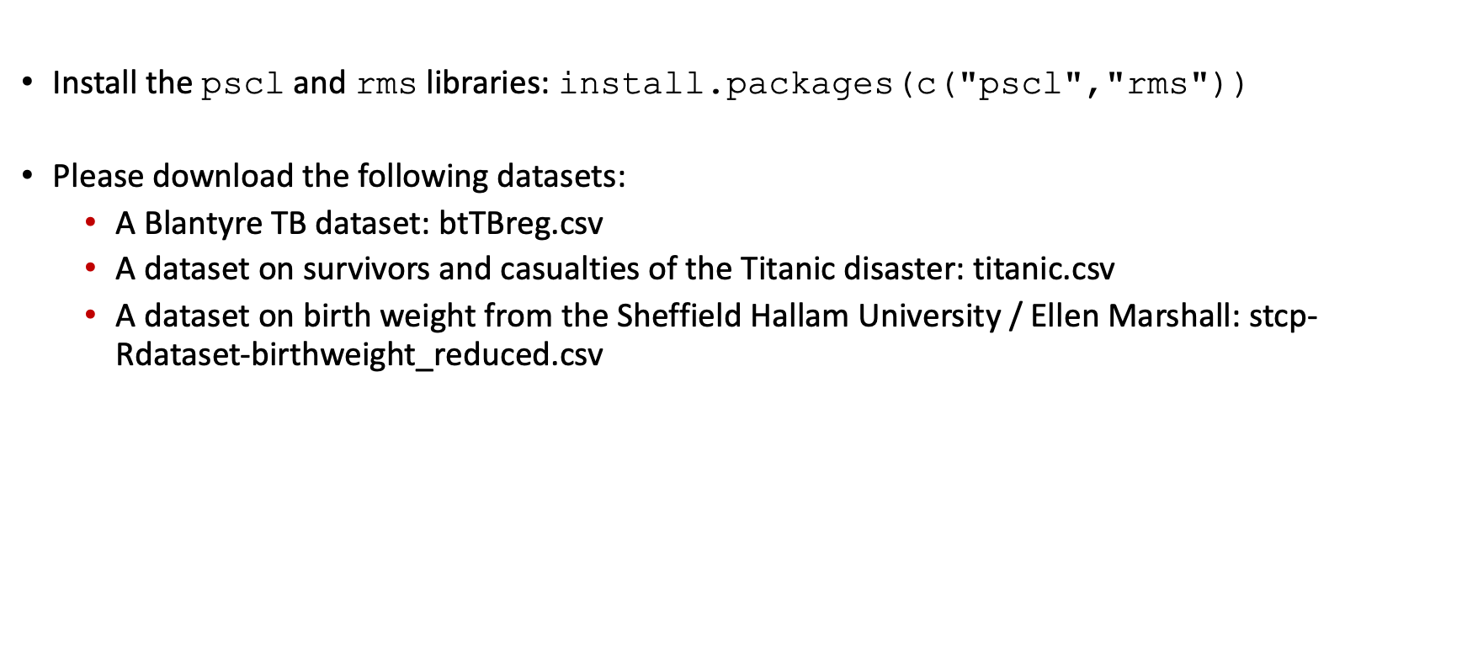
Libraries & data
Install the pscl and rms libraries: install.packages(c("pscl","rms"))
Please download the following datasets:
A Blantyre TB dataset: btTBreg.csv
A dataset on survivors and casualties of the Titanic disaster: titanic.csv
A dataset on birth weight from the Sheffield Hallam University / Ellen Marshall: stcp-Rdataset-birthweight_reduced.csv

Slide 7
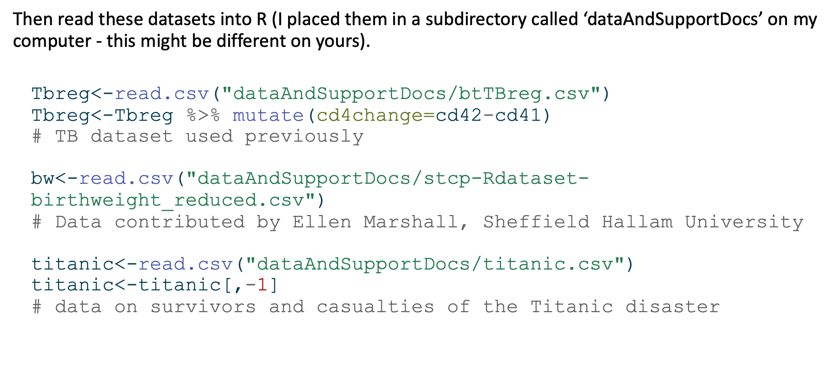
Libraries & data
Then read these datasets into R (I placed them in a subdirectory called ‘dataAndSupportDocs’ on my computer - this might be different on yours).
Tbreg<-read.csv("dataAndSupportDocs/btTBreg.csv") Tbreg<-Tbreg %>% mutate(cd4change=cd42-cd41) # TB dataset used previously bw<-read.csv("dataAndSupportDocs/stcp-Rdataset-birthweight_reduced.csv") # Data contributed by Ellen Marshall, Sheffield Hallam University titanic<-read.csv("dataAndSupportDocs/titanic.csv") titanic<-titanic[,-1] # data on survivors and casualties of the Titanic disaster

Slide 8
Linear model & correlation

Slide 9
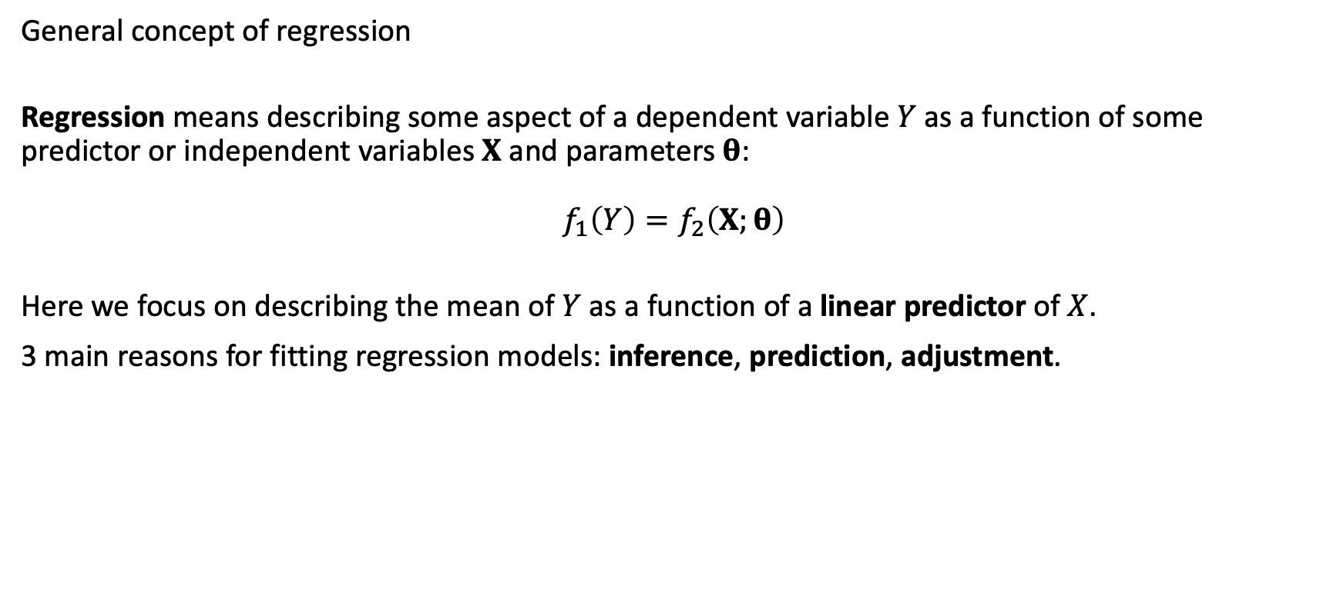
Linear model
General concept of regression
Regression means describing some aspect of a dependent variable $Y$ as a function of some predictor or independent variables $X$ and parameters $θ$:
$$f_{1}\left(Y\right)=f_{2}\left(X;θ\right)$$
Here we focus on describing the mean of $Y$ as a function of a linear predictor of $X$.
3 main reasons for fitting regression models: inference, prediction, adjustment.

Slide 10
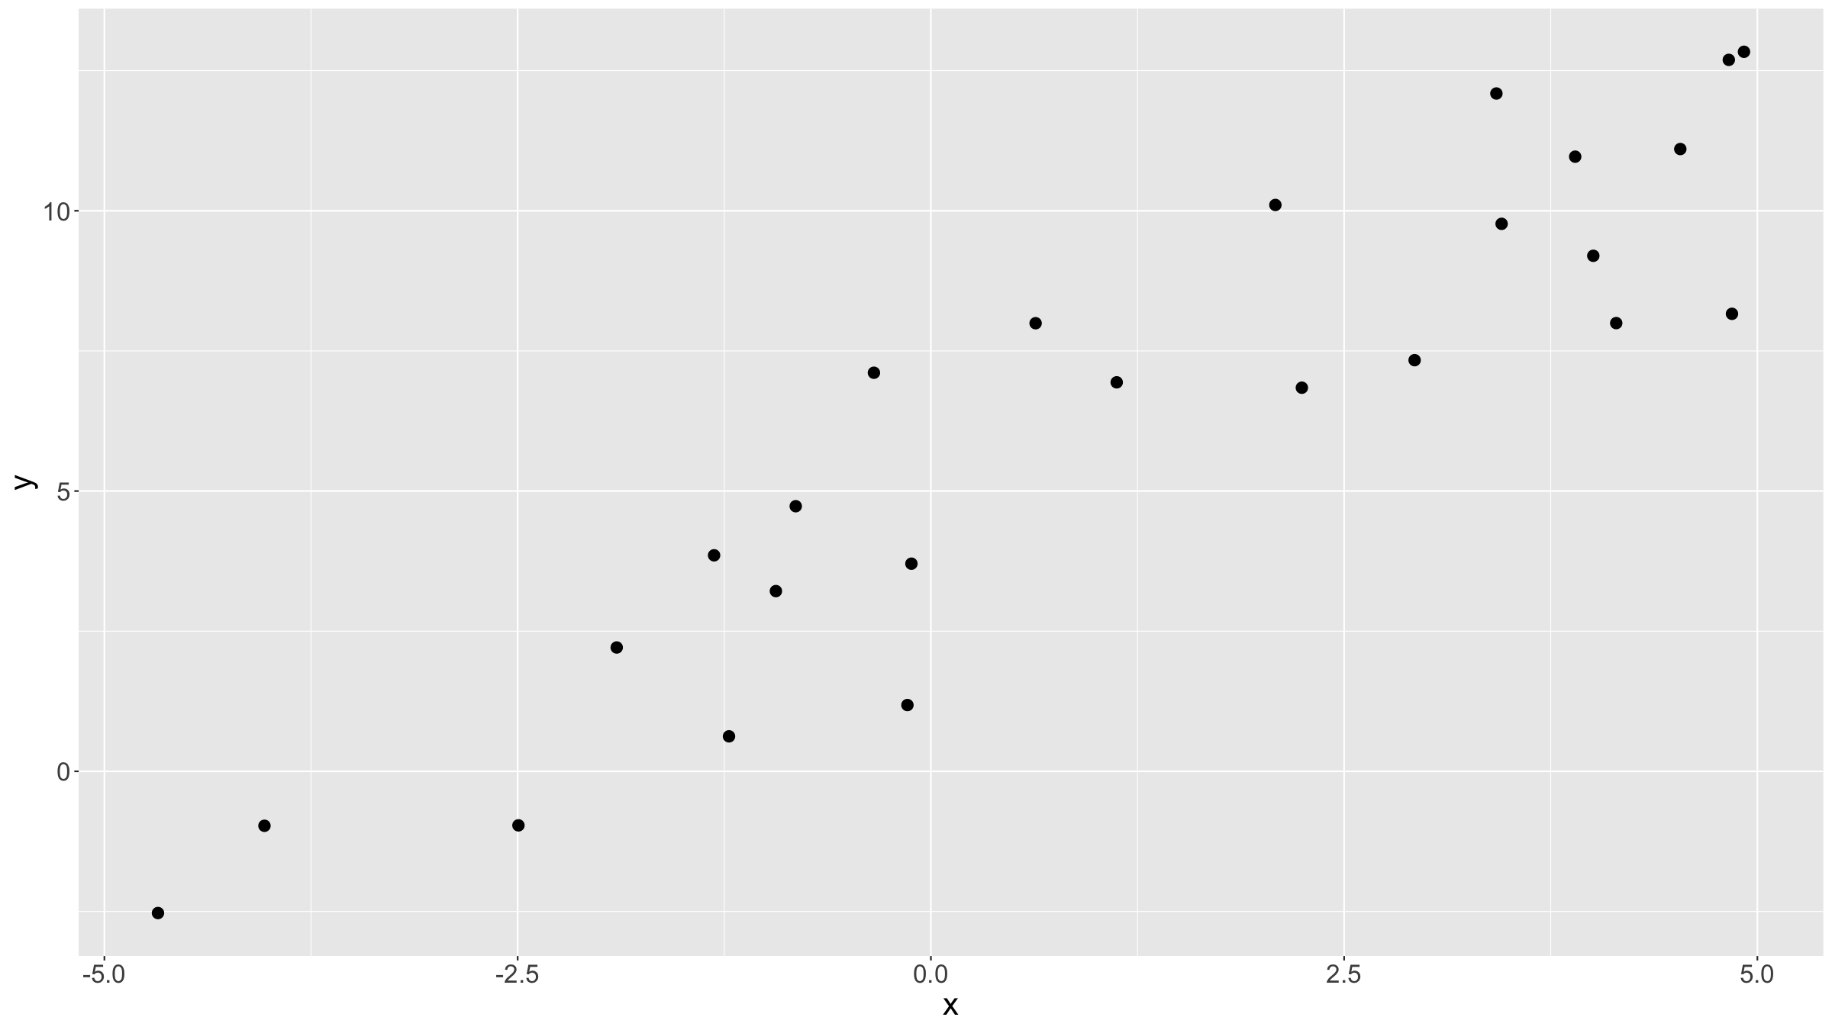
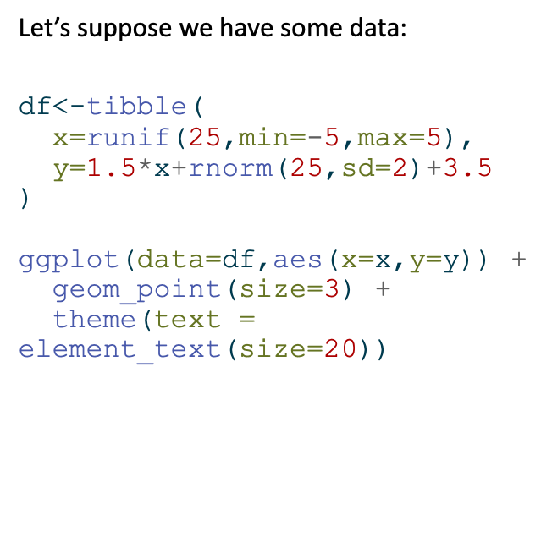
Linear model
Let’s suppose we have some data:
df<-tibble( x=runif(25,min=-5,max=5), y=1.5*x+rnorm(25,sd=2)+3.5 ) ggplot(data=df,aes(x=x,y=y)) + geom_point(size=3) + theme(text = element_text(size=20))

Slide 11
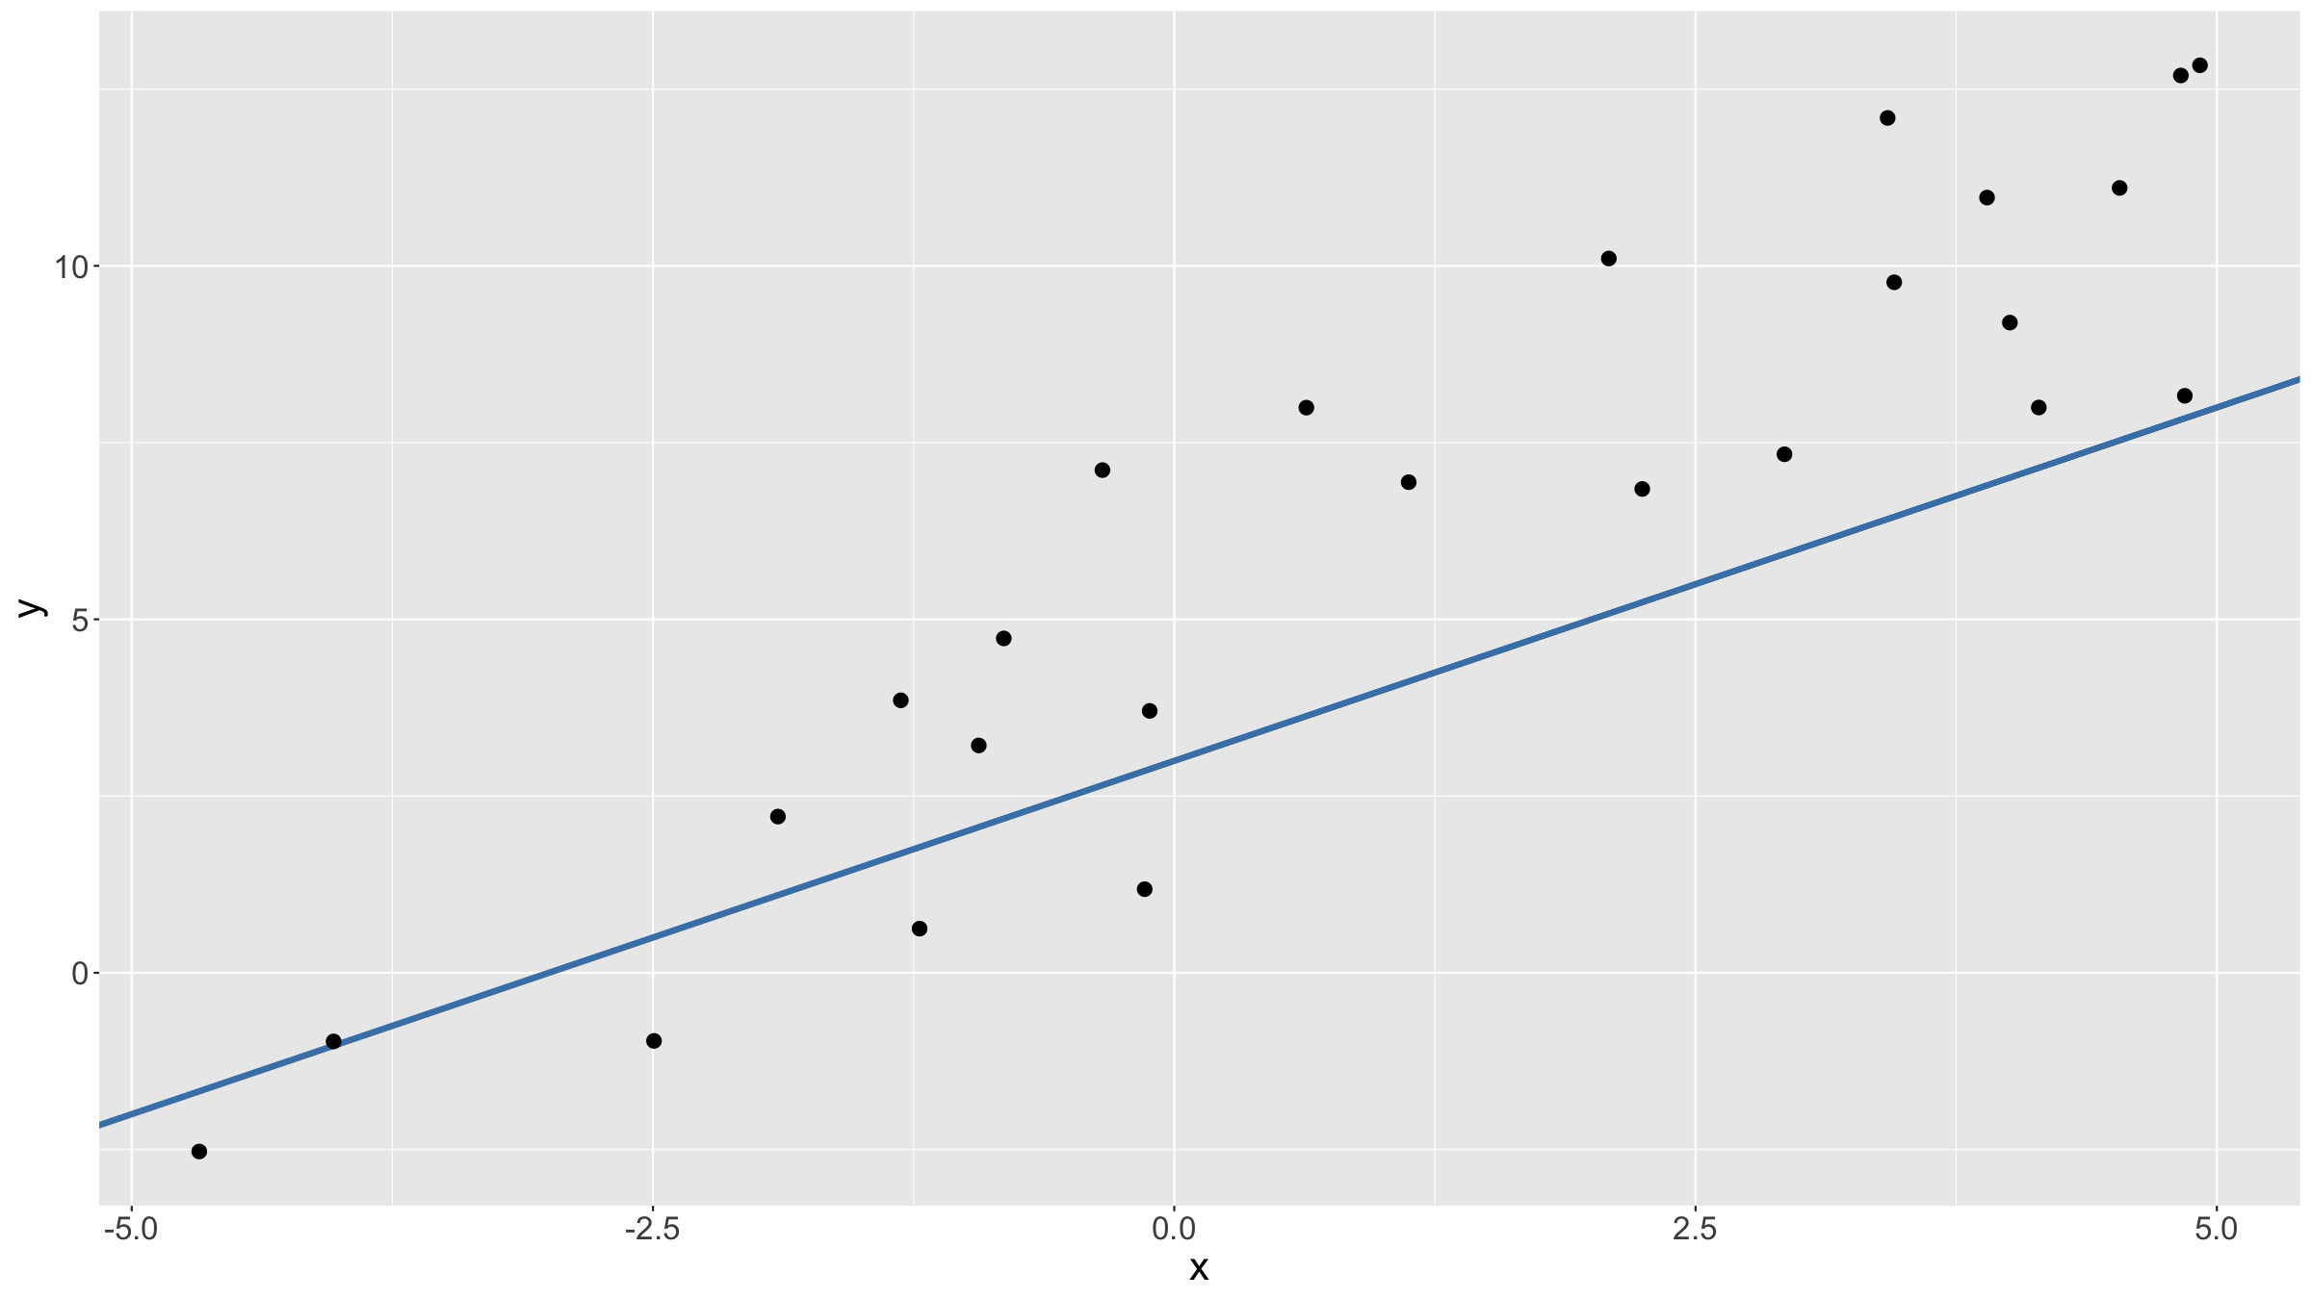
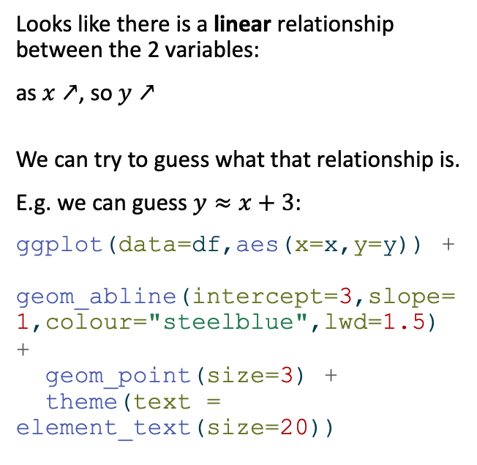
Linear model
Looks like there is a linear relationship between the 2 variables:
as $x↗$, so $y↗$
We can try to guess what that relationship is.
E.g. we can guess $y≈x+3$:
ggplot(data=df,aes(x=x,y=y)) + geom_abline(intercept=3,slope=1,colour="steelblue",lwd=1.5) + geom_point(size=3) + theme(text = element_text(size=20))

Slide 12
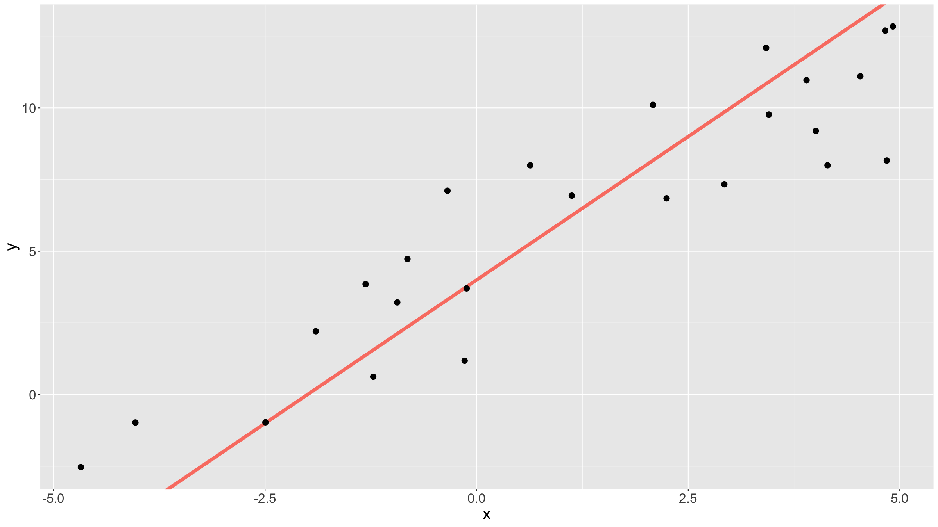
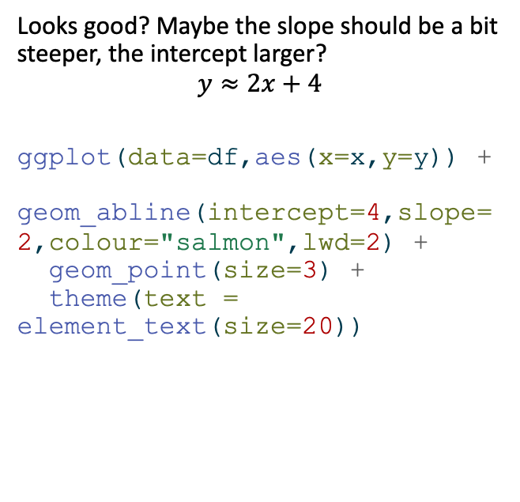
Linear model
Looks good? Maybe the slope should be a bit steeper, the intercept larger?
$$y≈2x+4$$
ggplot(data=df,aes(x=x,y=y)) + geom_abline(intercept=4,slope=2,colour="salmon",lwd=2) + geom_point(size=3) + theme(text = element_text(size=20))

Slide 13
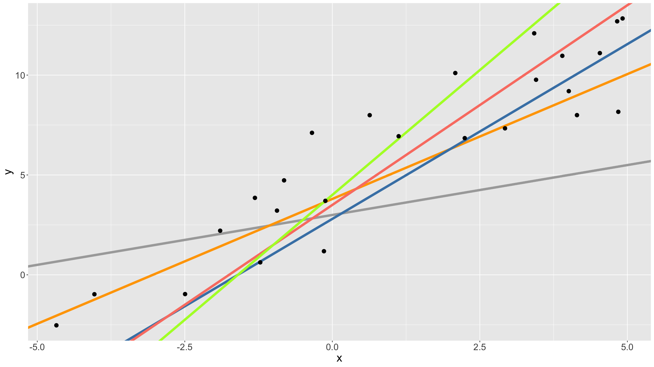
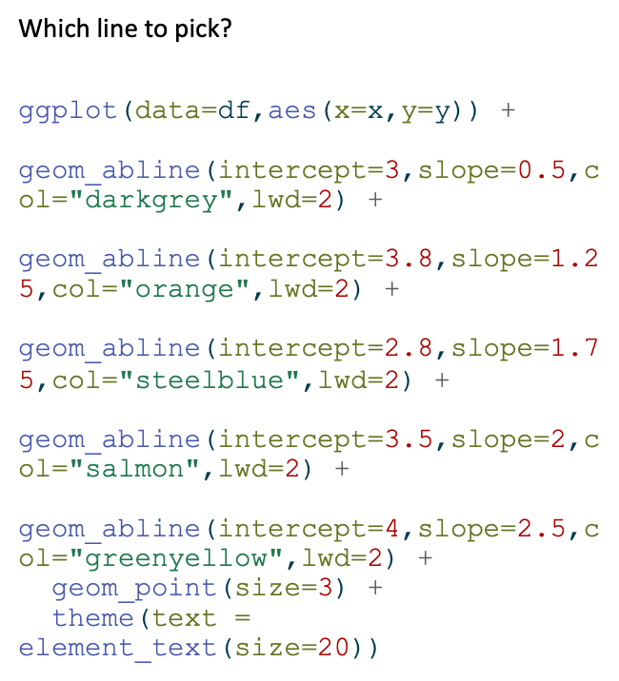
Linear model
Which line to pick?
ggplot(data=df,aes(x=x,y=y)) + geom_abline(intercept=3,slope=0.5,col="darkgrey",lwd=2) + geom_abline(intercept=3.8,slope=1.25,col="orange",lwd=2) + geom_abline(intercept=2.8,slope=1.75,col="steelblue",lwd=2) + geom_abline(intercept=3.5,slope=2,col="salmon",lwd=2) + geom_abline(intercept=4,slope=2.5,col="greenyellow",lwd=2) + geom_point(size=3) + theme(text = element_text(size=20))

Slide 14
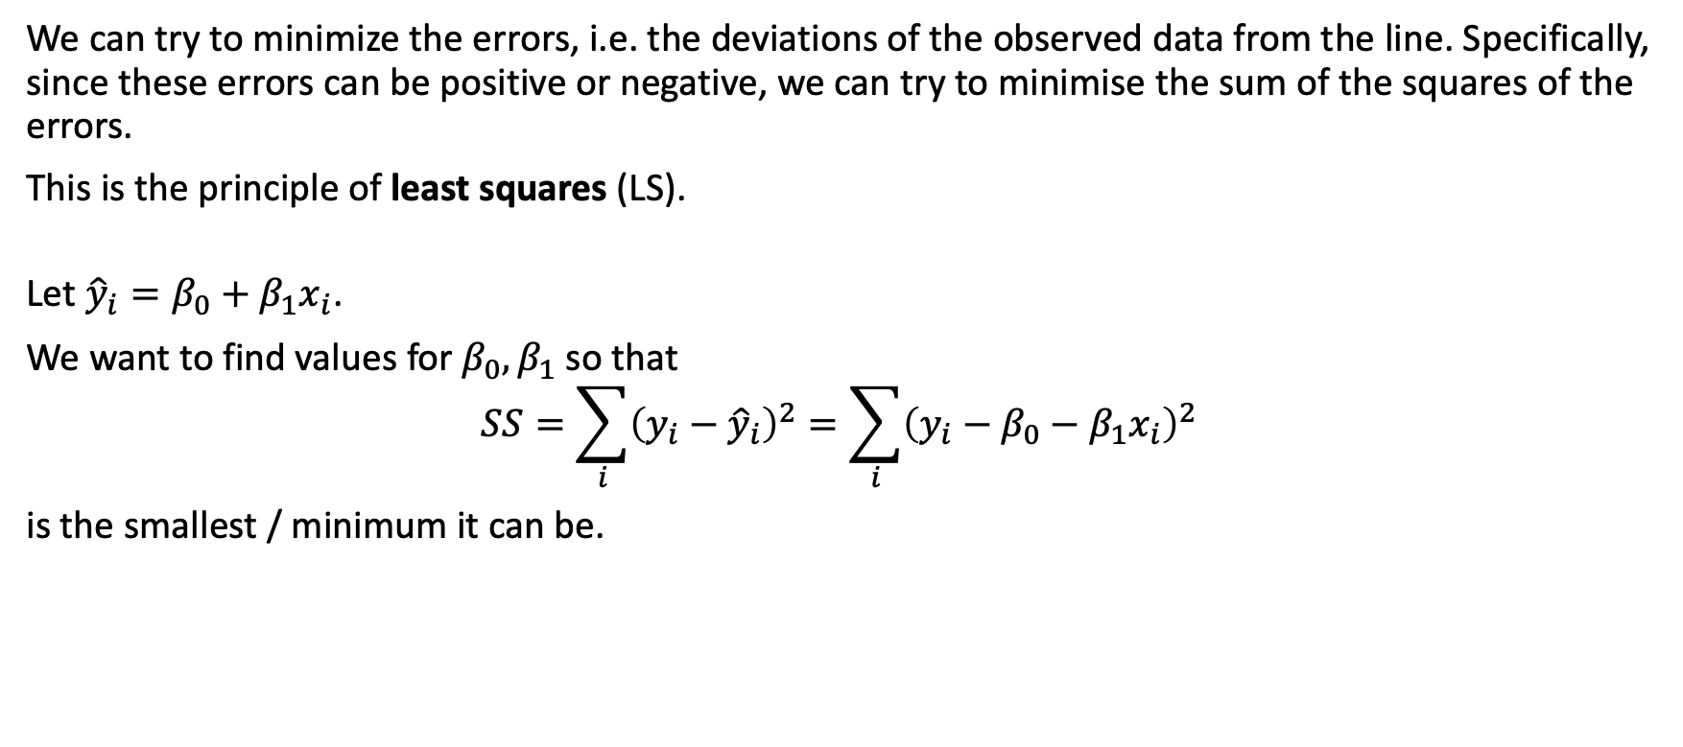
Linear model
We can try to minimize the errors, i.e. the deviations of the observed data from the line. Specifically, since these errors can be positive or negative, we can try to minimise the sum of the squares of the errors.
This is the principle of least squares (LS).
Let ${\hat{y}}_{i}=β_{0}+β_{1}x_{i}$.
We want to find values for $β_{0},β_{1}$ so that
$$SS=\sum_{i}^{​}{{\left(y_{i}−{\hat{y}}_{i}\right)}^{2}}=\sum_{i}^{​}{{\left(y_{i}−β_{0}−β_{1}x_{i}\right)}^{2}}$$
is the smallest / minimum it can be.

Slide 15
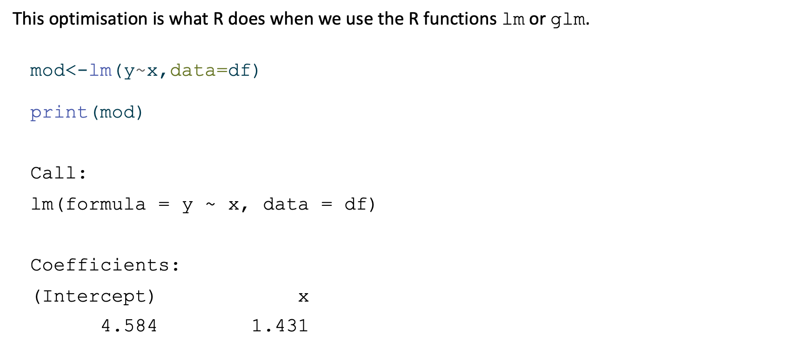
Linear model
This optimisation is what R does when we use the R functions lm or glm.
mod<-lm(y~x,data=df) print(mod)
Call: lm(formula = y ~ x, data = df) Coefficients: (Intercept) x 4.584 1.431

Slide 16
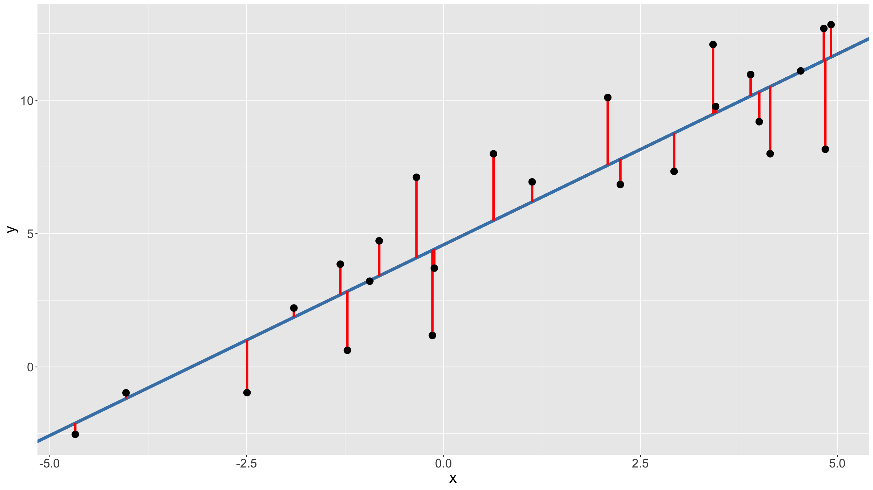
Linear model
ggplot(data=df,aes(x=x,y=y)) + geom_abline(intercept=coef(mod)[1],slope=coef(mod)[2],colour="steelblue",lwd=2) + geom_segment(aes(x=x,xend=x,y=y,yend=coef(mod)[2]*x+coef(mod)[1]),colour="red",lwd=1.5) + geom_point(size=4) + theme(text = element_text(size=20))

Slide 17
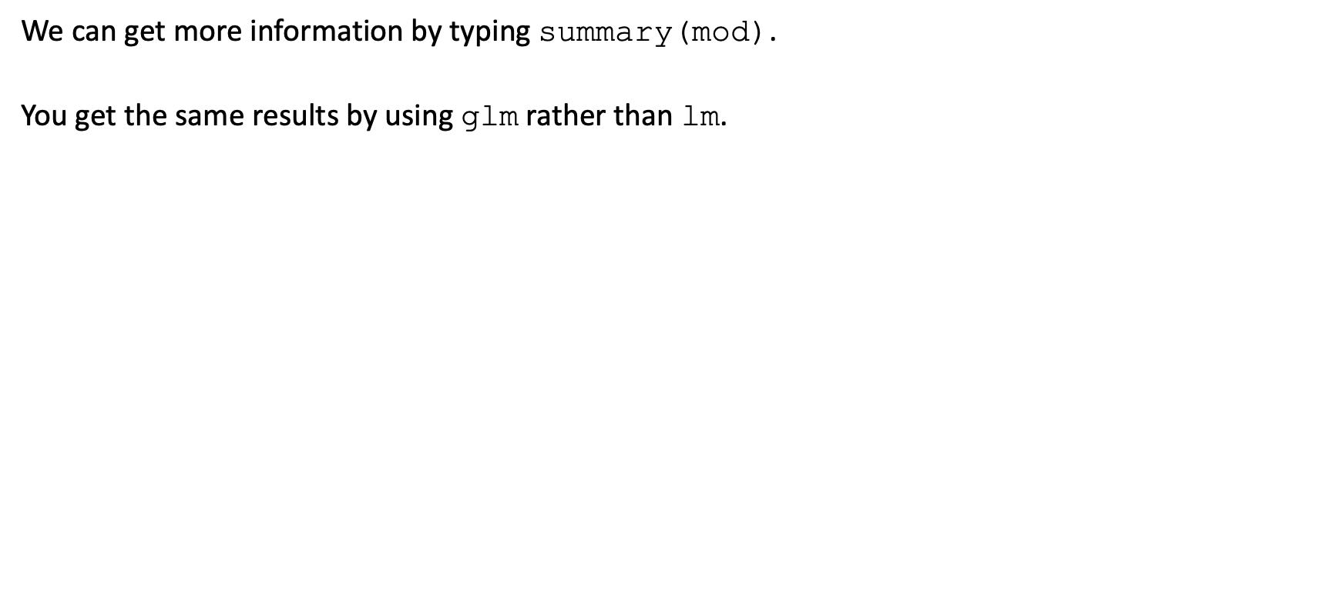
Linear model
We can get more information by typing summary(mod).
You get the same results by using glm rather than lm.

Slide 18
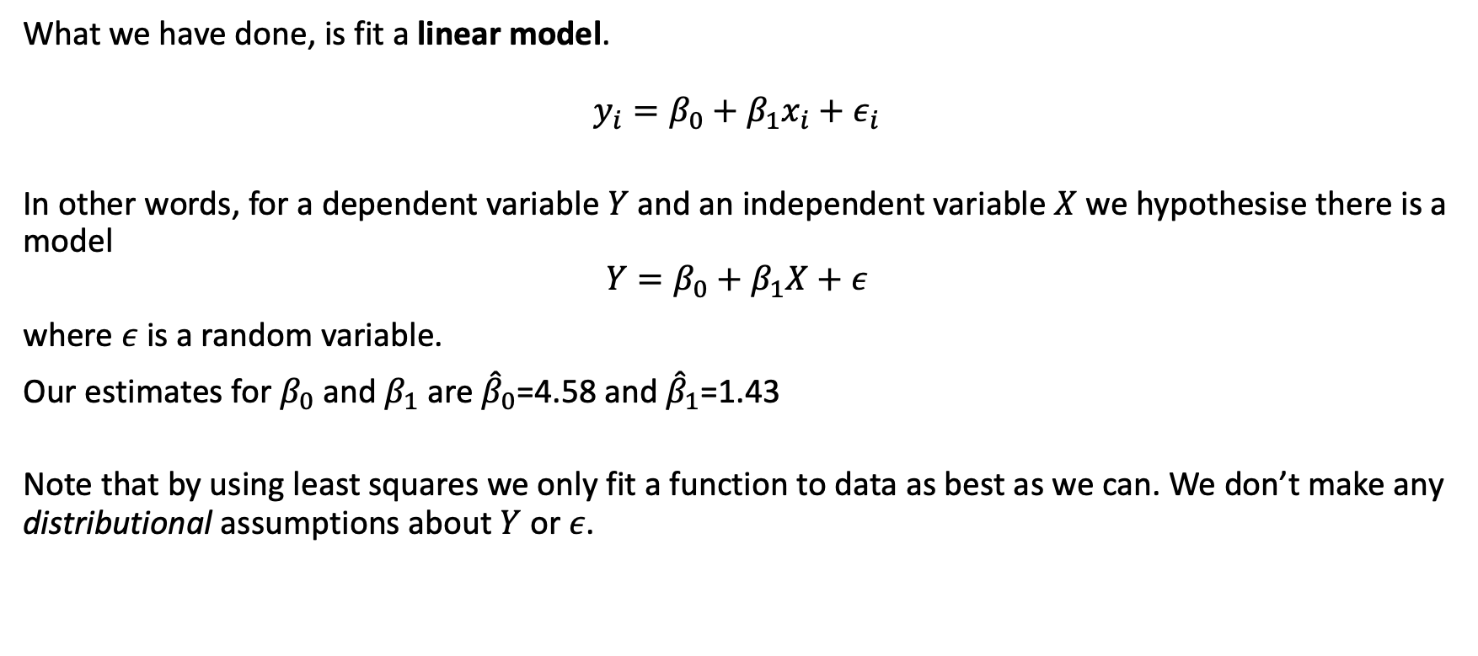
Linear model
What we have done, is fit a linear model.
$$y_{i}=β_{0}+β_{1}x_{i}+ε_{i}$$
In other words, for a dependent variable $Y$ and an independent variable $X$ we hypothesise there is a model
$$Y=β_{0}+β_{1}X+ε$$
where $ε$ is a random variable.
Our estimates for $β_{0}$ and $β_{1}$ are ${\hat{β}}_{0}$=4.58 and ${\hat{β}}_{1}$=1.43
Note that by using least squares we only fit a function to data as best as we can. We don’t make any distributional assumptions about $Y$ or $ε$.

Slide 19
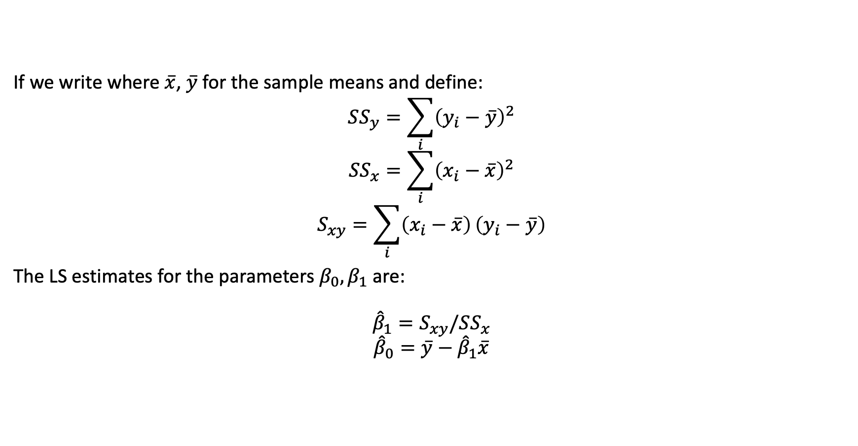
Linear model
If we write where $\overset{‾}{x}$, $\overset{‾}{y}$ for the sample means and define:
$$SS_{y}=\sum_{i}^{​}{{\left(y_{i}−\overset{‾}{y}\right)}^{2}}$$
$$SS_{x}=\sum_{i}^{​}{{\left(x_{i}−\overset{‾}{x}\right)}^{2}}$$
$$S_{xy}=\sum_{i}^{​}{\left(x_{i}−\overset{‾}{x}\right)}\left(y_{i}−\overset{‾}{y}\right)$$
The LS estimates for the parameters $β_{0},β_{1}$ are:
$${\hat{β}}_{1}=S_{xy}/SS_{x}$$
$${\hat{β}}_{0}=\overset{‾}{y}−{\hat{β}}_{1}\overset{‾}{x}$$

Slide 20
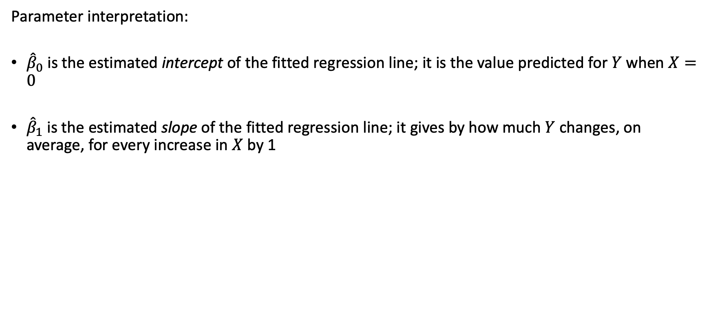
Linear model
Parameter interpretation:
${\hat{β}}_{0}$ is the estimated intercept of the fitted regression line; it is the value predicted for $Y$ when $X=0$
${\hat{β}}_{1}$ is the estimated slope of the fitted regression line; it gives by how much $Y$ changes, on average, for every increase in $X$ by 1

Slide 21
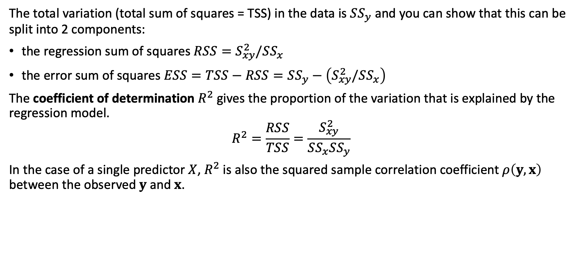
Linear model
The total variation (total sum of squares = TSS) in the data is $SS_{y}$ and you can show that this can be split into 2 components:
the regression sum of squares $RSS=S_{xy}^{2}/SS_{x}$
the error sum of squares $ESS=TSS−RSS=SS_{y}−\left(S_{xy}^{2}/SS_{x}\right)$
The coefficient of determination $R^{2}$ gives the proportion of the variation that is explained by the regression model.
$$R^{2}=\frac{RSS}{TSS}=\frac{S_{xy}^{2}}{SS_{x}SS_{y}}$$
In the case of a single predictor $X$, $R^{2}$ is also the squared sample correlation coefficient $ρ\left(y,x\right)$ between the observed $y$ and $x$.

Slide 22
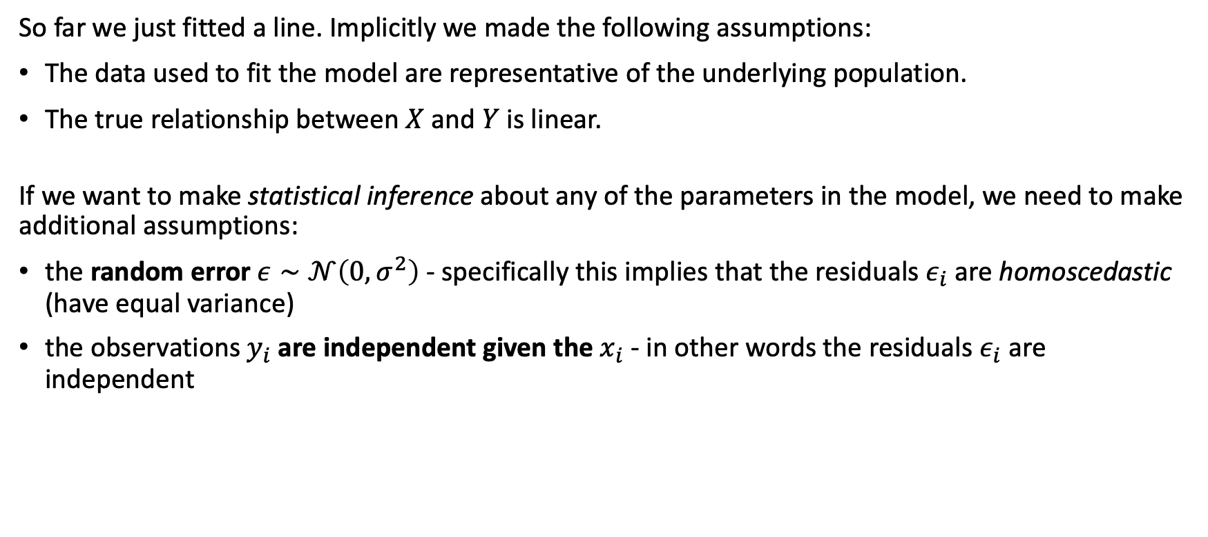
Linear model
So far we just fitted a line. Implicitly we made the following assumptions:
The data used to fit the model are representative of the underlying population.
The true relationship between $X$ and $Y$ is linear.
If we want to make statistical inference about any of the parameters in the model, we need to make additional assumptions:
the random error $ε∼𝒩\left(0,σ^{2}\right)$ - specifically this implies that the residuals $ε_{i}$ are homoscedastic (have equal variance)
the observations $y_{i}$ are independent given the $x_{i}$ - in other words the residuals $ε_{i}$ are independent

Slide 23
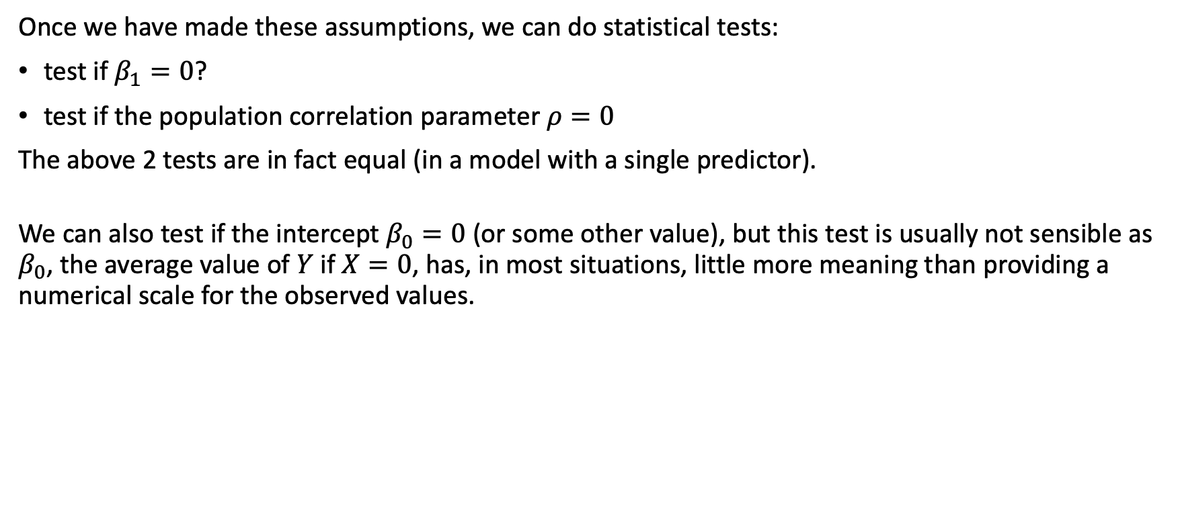
Linear model
Once we have made these assumptions, we can do statistical tests:
test if $β_{1}=0$?
test if the population correlation parameter $ρ=0$
The above 2 tests are in fact equal (in a model with a single predictor).
We can also test if the intercept $β_{0}=0$ (or some other value), but this test is usually not sensible as $β_{0}$, the average value of $Y$ if $X=0$, has, in most situations, little more meaning than providing a numerical scale for the observed values.

Slide 24
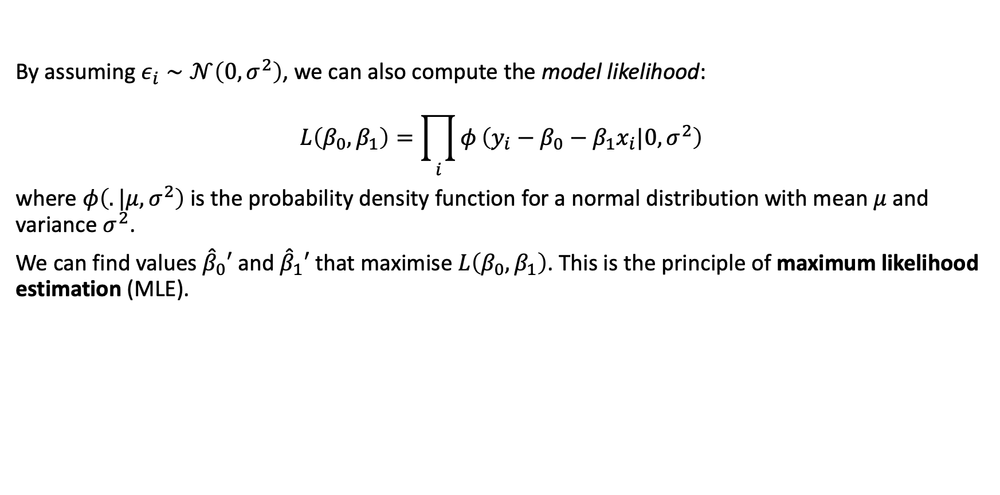
Linear model
By assuming $ε_{i}∼𝒩\left(0,σ^{2}\right)$, we can also compute the model likelihood:
$$L\left(β_{0},β_{1}\right)=\prod_{i}^{​}{φ}\left(y_{i}−β_{0}−β_{1}x_{i}|0,σ^{2}\right)$$
where $φ\left(.|μ,σ^{2}\right)$ is the probability density function for a normal distribution with mean $μ$ and variance $σ^{2}$.
We can find values ${\hat{β}}_{0}′$ and ${\hat{β}}_{1}′$ that maximise $L\left(β_{0},β_{1}\right)$. This is the principle of maximum likelihood estimation (MLE).

Slide 25
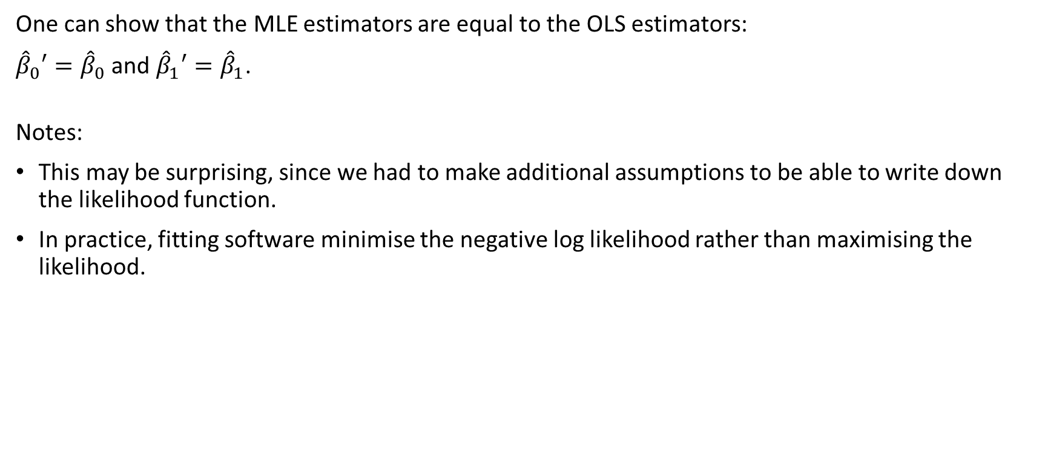
Linear model
One can show that the MLE estimators are equal to the OLS estimators:
${\hat{β}}_{0}′={\hat{β}}_{0}$ and ${\hat{β}}_{1}′={\hat{β}}_{1}$.
Notes:
This may be surprising, since we had to make additional assumptions to be able to write down the likelihood function.
In practice, fitting software minimise the negative log likelihood rather than maximising the likelihood.

Slide 26
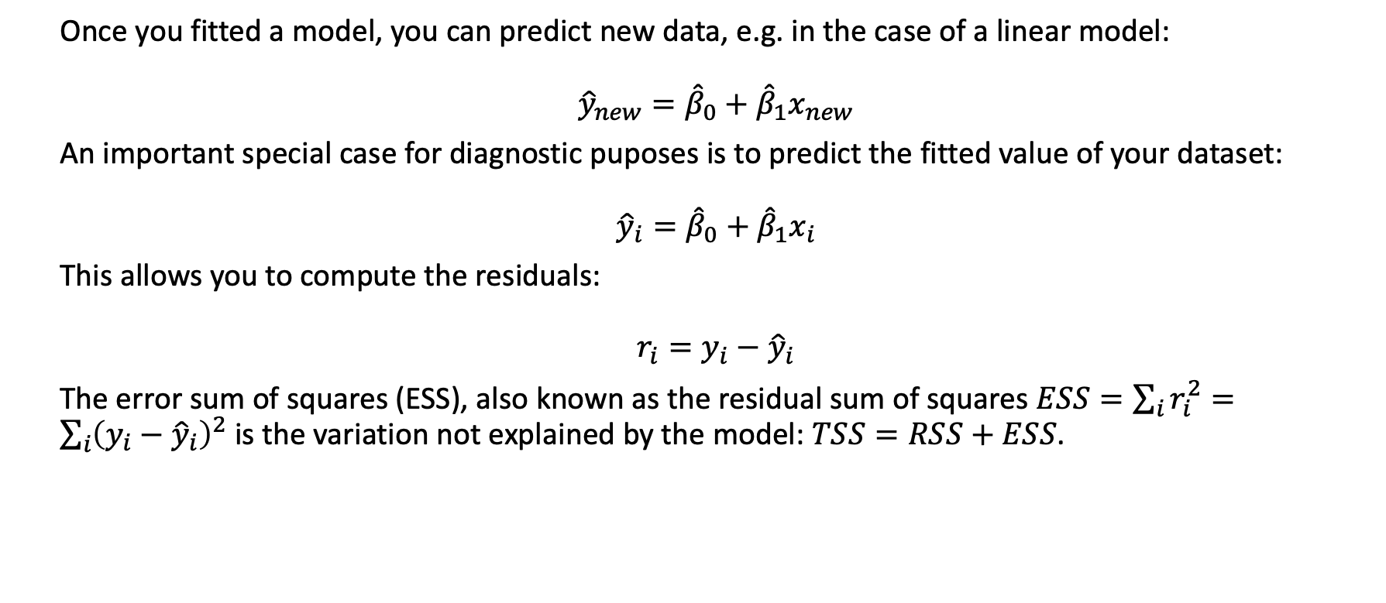
Linear model
Once you fitted a model, you can predict new data, e.g. in the case of a linear model:
$${\hat{y}}_{new}={\hat{β}}_{0}+{\hat{β}}_{1}x_{new}$$
An important special case for diagnostic puposes is to predict the fitted value of your dataset:
$${\hat{y}}_{i}={\hat{β}}_{0}+{\hat{β}}_{1}x_{i}$$
This allows you to compute the residuals:
$$r_{i}=y_{i}−{\hat{y}}_{i}$$
The error sum of squares (ESS), also known as the residual sum of squares $ESS=\sum_{i}^{​}{r_{i}^{2}}=\sum_{i}^{​}{{\left(y_{i}−{\hat{y}}_{i}\right)}^{2}}$ is the variation not explained by the model: $TSS=RSS+ESS$.

Slide 27
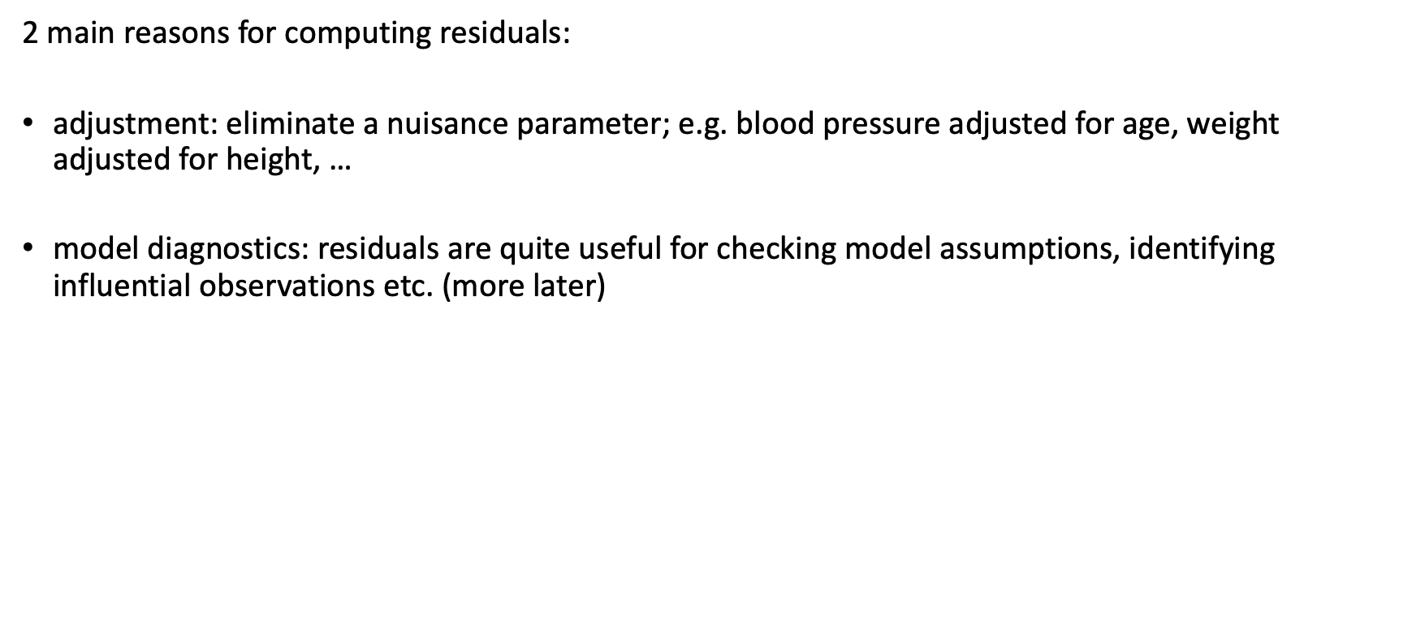
Linear model
2 main reasons for computing residuals:
adjustment: eliminate a nuisance parameter; e.g. blood pressure adjusted for age, weight adjusted for height, …
model diagnostics: residuals are quite useful for checking model assumptions, identifying influential observations etc. (more later)

Slide 28
Linear model - Example
Let us fit a linear model in R and interpret the results
m1 <- lm(Birthweight ~ Gestation, data= bw)
summary(m1)
## summary(m1)
## Call:
## lm(formula = Birthweight ~ Gestation, data = bw)
## Coefficients:
## Estimate Std. Error t value Pr(>|t|)
## (Intercept) -6.66019 2.21162 -3.011 0.00449 **
## Gestation 0.35530 0.05631 6.310 1.73e-07 ***
## ---
## Signif. codes: 0 ‘***’ 0.001 ‘**’ 0.01 ‘*’ 0.05 ‘.’ 0.1 ‘ ’ 1
m12 <- glm(Birthweight ~ Gestation, data= bw)
summary(m12)

Slide 29
Generalised linear model

Slide 30
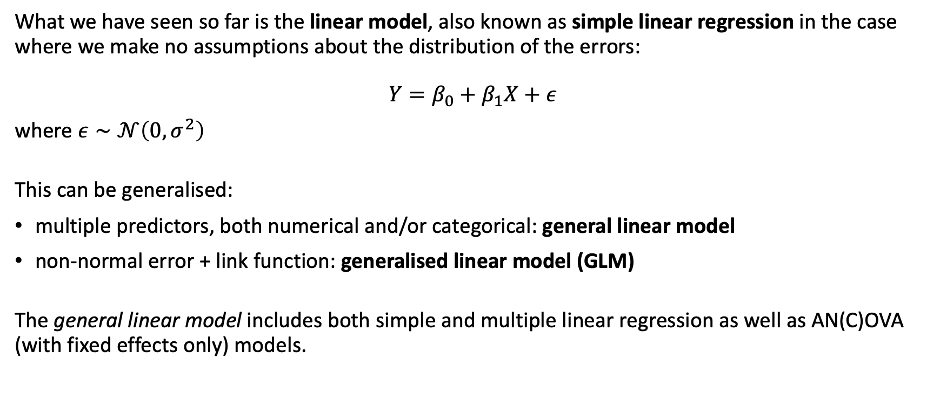
Generalised linear model
What we have seen so far is the linear model, also known as simple linear regression in the case where we make no assumptions about the distribution of the errors:
$$Y=β_{0}+β_{1}X+ε$$
where $ε∼𝒩\left(0,σ^{2}\right)$
This can be generalised:
multiple predictors, both numerical and/or categorical: general linear model
non-normal error + link function: generalised linear model (GLM)
The general linear model includes both simple and multiple linear regression as well as AN(C)OVA (with fixed effects only) models.

Slide 31
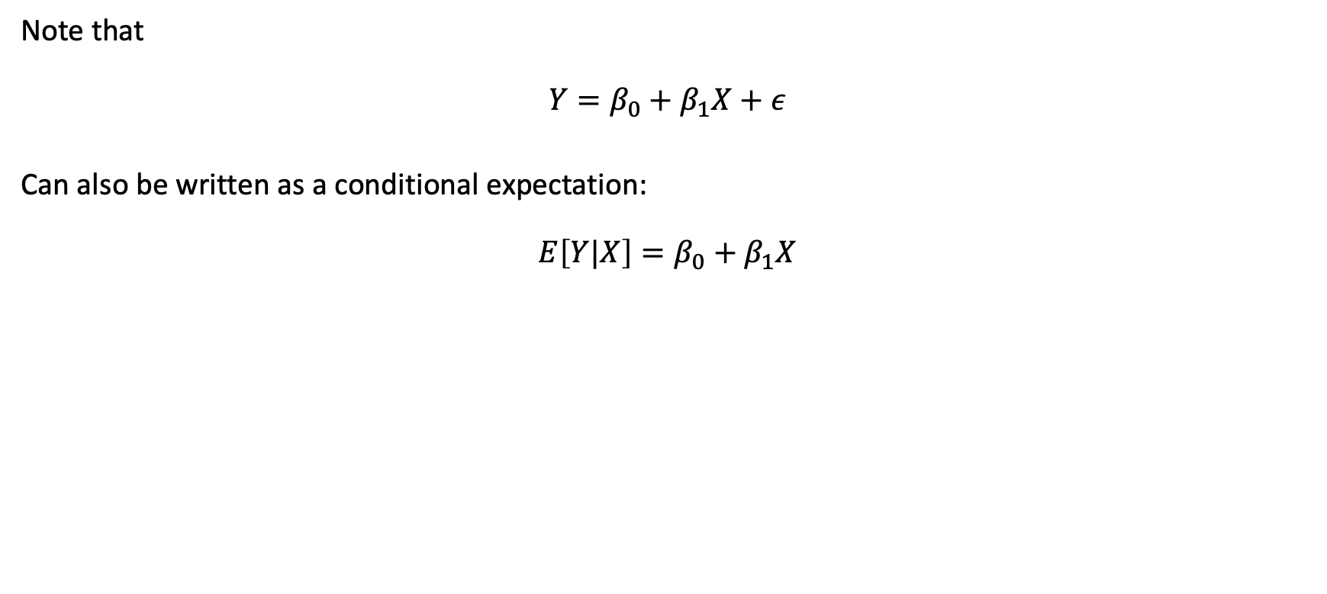
Generalised linear model
Note that
$$Y=β_{0}+β_{1}X+ε$$
Can also be written as a conditional expectation:
$$E\left[Y|X\right]=β_{0}+β_{1}X$$

Slide 32
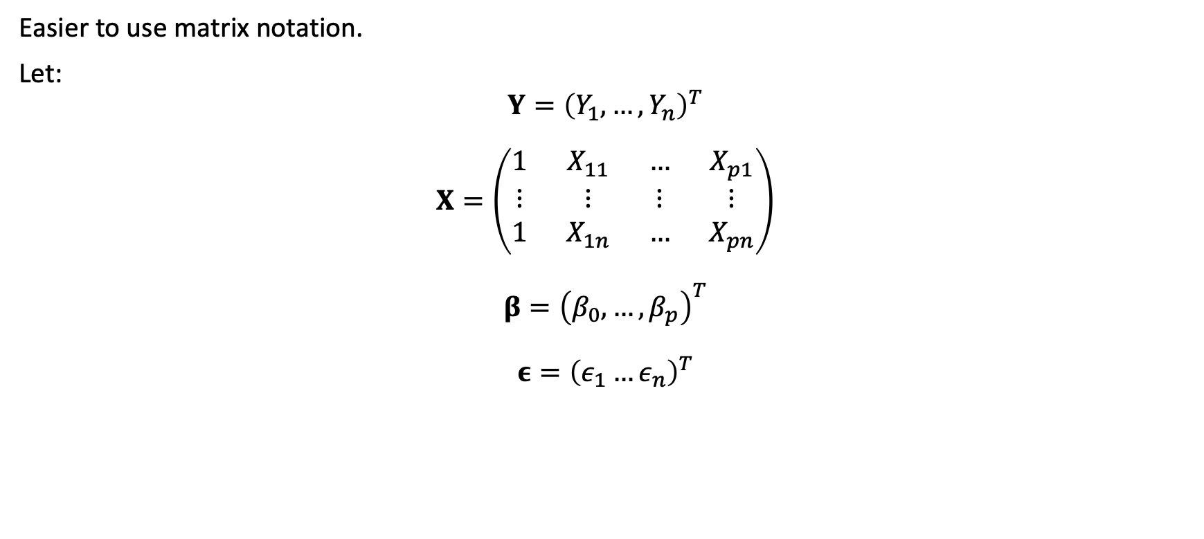
Generalised linear model
Easier to use matrix notation.
Let:
$$Y={\left(Y_{1},…,Y_{n}\right)}^{T}$$
$$X=\left(\begin{matrix}1 & X_{11} & … & X_{p1} \\ ⋮ & ⋮ & ⋮ & ⋮ \\ 1 & X_{1n} & … & X_{pn}\end{matrix}\right)$$
$$β={\left(β_{0},…,β_{p}\right)}^{T}$$
$$ε={\left(ε_{1}…ε_{n}\right)}^{T}$$

Slide 33
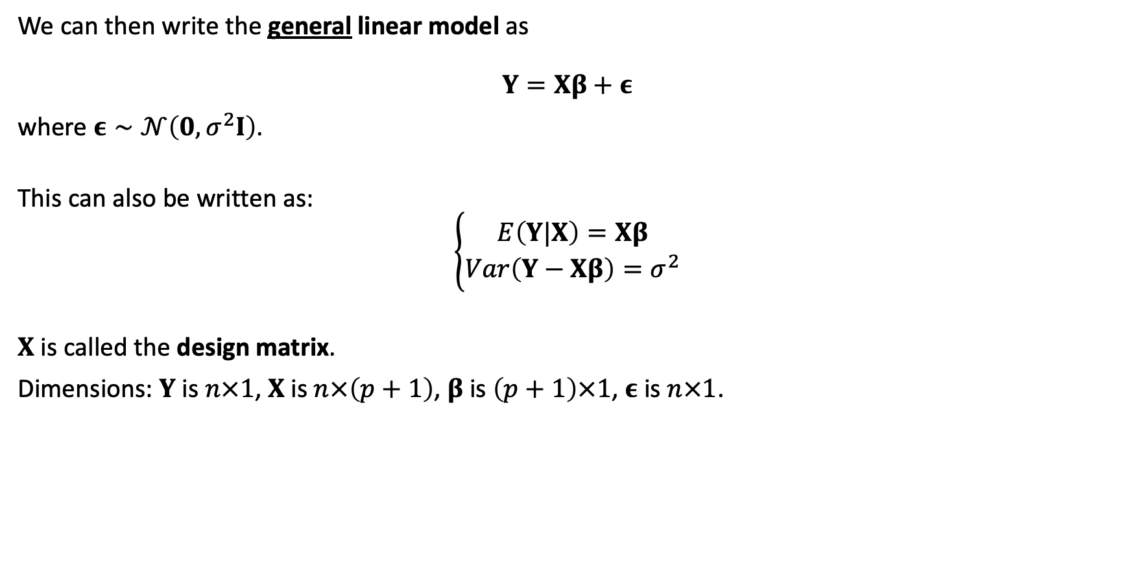
Generalised linear model
We can then write the general linear model as
$$Y=Xβ+ε$$
where $ε∼𝒩\left(0,σ^{2}I\right)$.
This can also be written as:
$$\left\{\begin{matrix}E\left(Y|X\right)=Xβ \\ Var\left(Y−Xβ\right)=σ^{2}\end{matrix}\right.$$
$X$ is called the design matrix.
Dimensions: $Y$ is $n×1$, $X$ is $n×\left(p+1\right)$, $β$ is $\left(p+1\right)×1$, $ε$ is $n×1$.

Slide 34
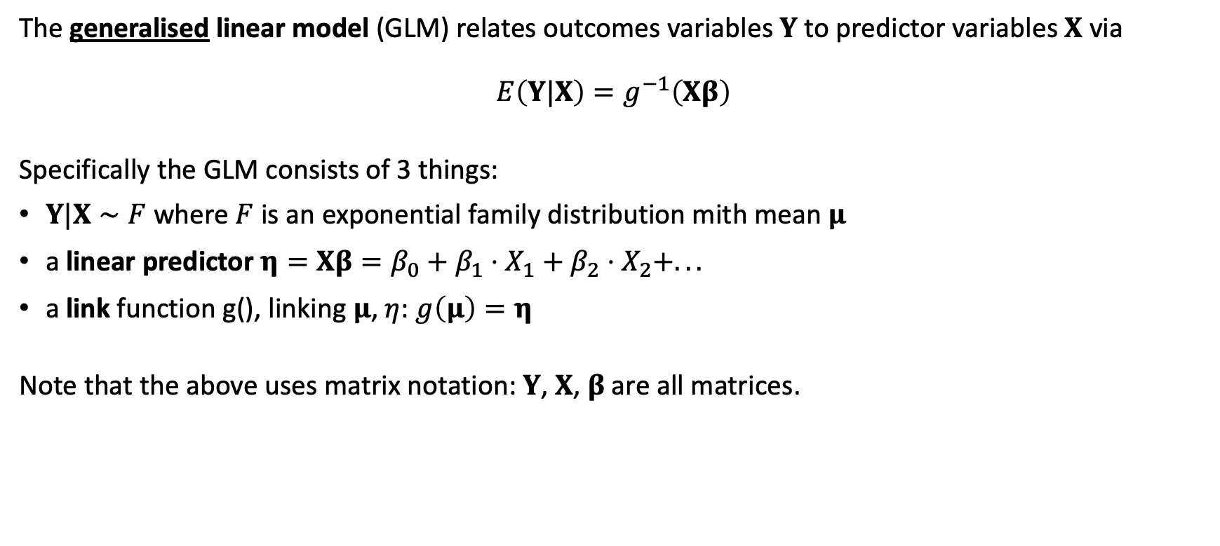
Generalised linear model
The generalised linear model (GLM) relates outcomes variables $Y$ to predictor variables $X$ via
$$E\left(Y|X\right)=g^{−1}\left(Xβ\right)$$
Specifically the GLM consists of 3 things:
$Y|X∼F$ where $F$ is an exponential family distribution mith mean $μ$
a linear predictor $η=Xβ=β_{0}+β_{1}⋅X_{1}+β_{2}⋅X_{2}+...$
a link function g(), linking $μ$, $η$: $g\left(μ\right)=η$
Note that the above uses matrix notation: $Y$, $X$, $β$ are all matrices.

Slide 35
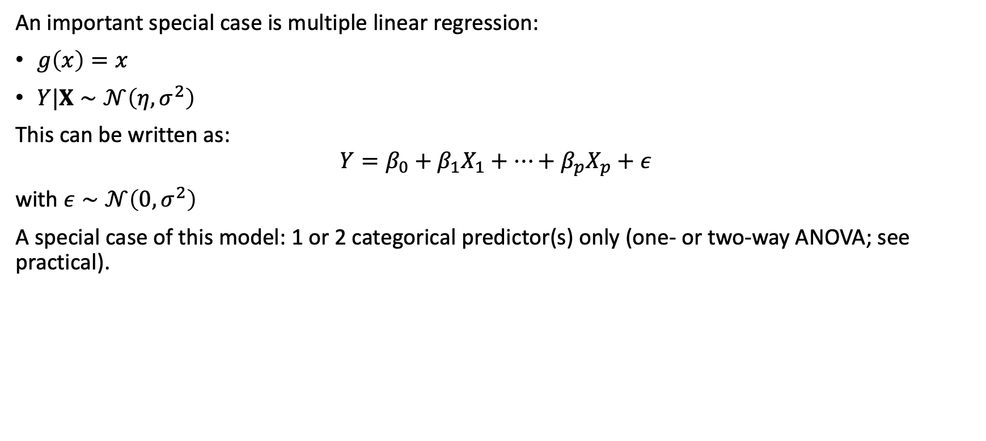
Generalised linear model
An important special case is multiple linear regression:
$g\left(x\right)=x$
$Y|X∼𝒩\left(η,σ^{2}\right)$
This can be written as:
$$Y=β_{0}+β_{1}X_{1}+…+β_{p}X_{p}+ε$$
with $ε∼𝒩\left(0,σ^{2}\right)$
A special case of this model: 1 or 2 categorical predictor(s) only (one- or two-way ANOVA; see practical).

Slide 36
Generalised linear model
Same model we fitted before with lm():
modAlt<-glm(y~x,data=df,family=gaussian("identity")) summary(modAlt) ## ## Call: ## glm(formula = y ~ x, family = gaussian("identity"), data = df) ## ## Coefficients: ## Estimate Std. Error t value Pr(>|t|) ## (Intercept) 4.5840 0.3969 11.55 4.72e-11 *** ## x 1.4309 0.1292 11.08 1.07e-10 *** ## --- ## Signif. codes: 0 '***' 0.001 '**' 0.01 '*' 0.05 '.' 0.1 ' ' 1 ## ## (Dispersion parameter for gaussian family taken to be 3.374296) ## ## Null deviance: 491.810 on 24 degrees of freedom ## Residual deviance: 77.609 on 23 degrees of freedom ## AIC: 105.27 ## ## Number of Fisher Scoring iterations: 2

Slide 37
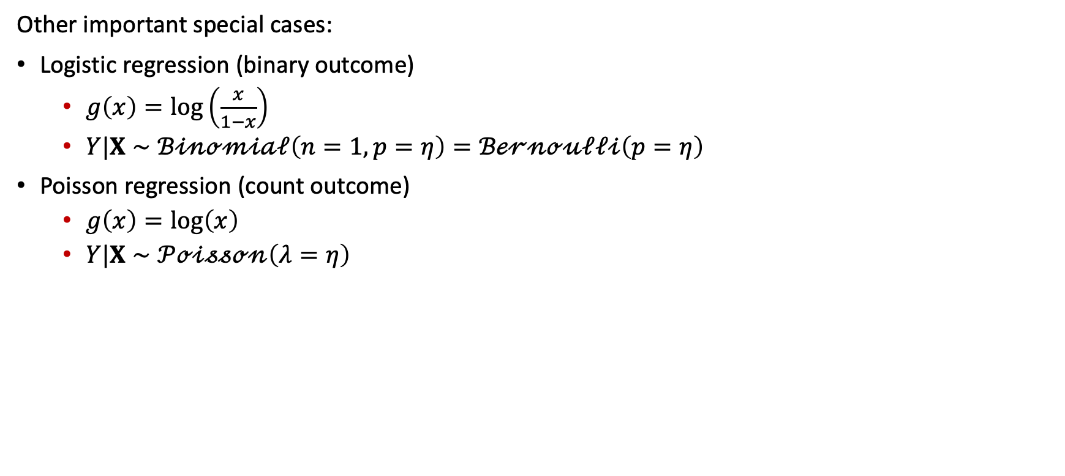
Generalised linear model
Other important special cases:
Logistic regression (binary outcome)
$g\left(x\right)=log\left(\frac{x}{1−x}\right)$
$Y|X∼ℬ𝒾𝓃ℴ𝓂𝒾𝒶𝓁\left(n=1,p=η\right)=ℬℯ𝓇𝓃ℴ𝓊𝓁𝓁𝒾\left(p=η\right)$
Poisson regression (count outcome)
$g\left(x\right)=log\left(x\right)$
$Y|X∼𝒫ℴ𝒾𝓈𝓈ℴ𝓃\left(λ=η\right)$

Slide 38
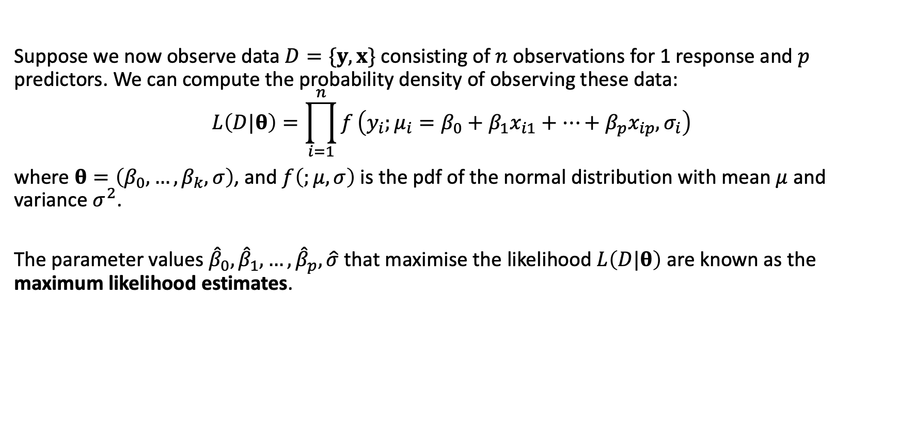
Generalised linear model
Suppose we now observe data $D=\{y,x\}$ consisting of $n$ observations for 1 response and $p$ predictors. We can compute the probability density of observing these data:
$$L\left(D|θ\right)=\prod_{i=1}^{n}{f}\left(y_{i};μ_{i}=β_{0}+β_{1}x_{i1}+…+β_{p}x_{ip},σ_{i}\right)$$
where $θ=\left(β_{0},…,β_{k},σ\right)$, and $f\left(;μ,σ\right)$ is the pdf of the normal distribution with mean $μ$ and variance $σ^{2}$.
The parameter values ${\hat{β}}_{0},{\hat{β}}_{1},…,{\hat{β}}_{p},\hat{σ}$ that maximise the likelihood $L\left(D|θ\right)$ are known as the maximum likelihood estimates.

Slide 39
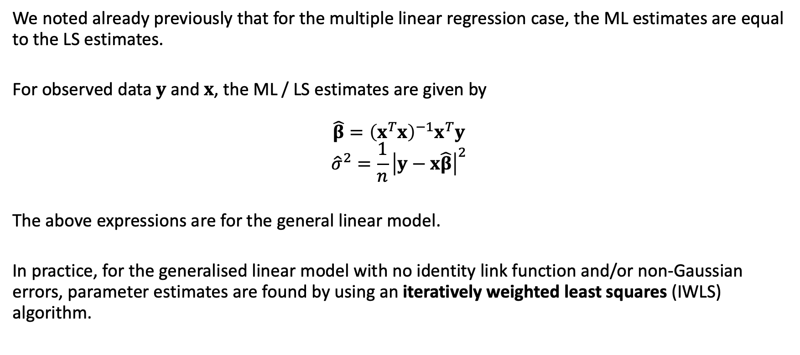
Generalised linear model
We noted already previously that for the multiple linear regression case, the ML estimates are equal to the LS estimates.
For observed data $y$ and $x$, the ML / LS estimates are given by
$$\hat{β}={\left(x^{T}x\right)}^{−1}x^{T}y$$
$${\hat{σ}}^{2}=\frac{1}{n}{\left|y−x\hat{β}\right|}^{2}$$
The above expressions are for the general linear model.
In practice, for the generalised linear model with no identity link function and/or non-Gaussian errors, parameter estimates are found by using an iteratively weighted least squares (IWLS) algorithm.

Slide 40
Generalised linear model
Recap:
Independent observations, true relation between response and predictor(s) is linear: linear regression.
Normal distribution of errors / residuals, continuous & categorical predictors, linear predictor is linear in parameters (not necessarily in the predictors): general linear model.
Link function, exponential-family distribution for errors / residuals: generalised linear model (GLM).

Slide 41
Statistical inference for GLMs

Slide 42
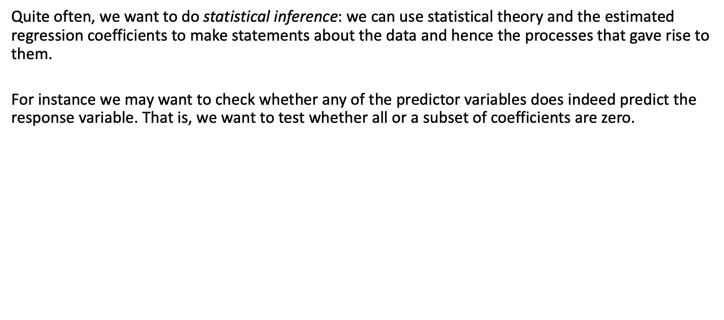
Inference for GLMs
Quite often, we want to do statistical inference: we can use statistical theory and the estimated regression coefficients to make statements about the data and hence the processes that gave rise to them.
For instance we may want to check whether any of the predictor variables does indeed predict the response variable. That is, we want to test whether all or a subset of coefficients are zero.

Slide 43
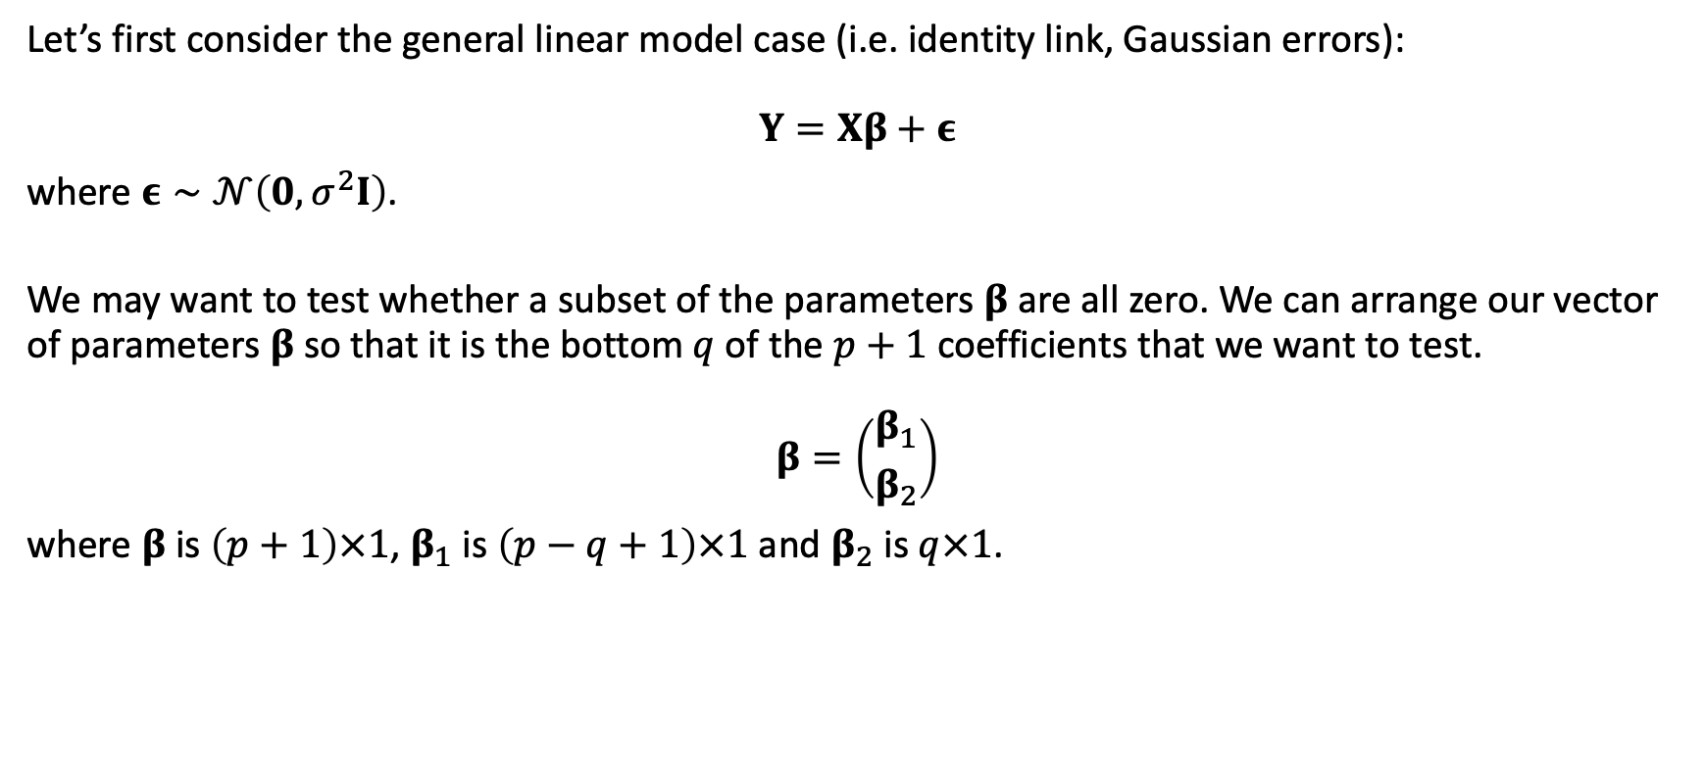
Inference for GLMs
Let’s first consider the general linear model case (i.e. identity link, Gaussian errors):
$$Y=Xβ+ε$$
where $ε∼𝒩\left(0,σ^{2}I\right)$.
We may want to test whether a subset of the parameters $β$ are all zero. We can arrange our vector of parameters $β$ so that it is the bottom $q$ of the $p+1$ coefficients that we want to test.
$$β=\left({β_{1} \atop β_{2}}\right)$$
where $β$ is $\left(p+1\right)×1$, $β_{1}$ is $\left(p−q+1\right)×1$ and $β_{2}$ is $q×1$.

Slide 44
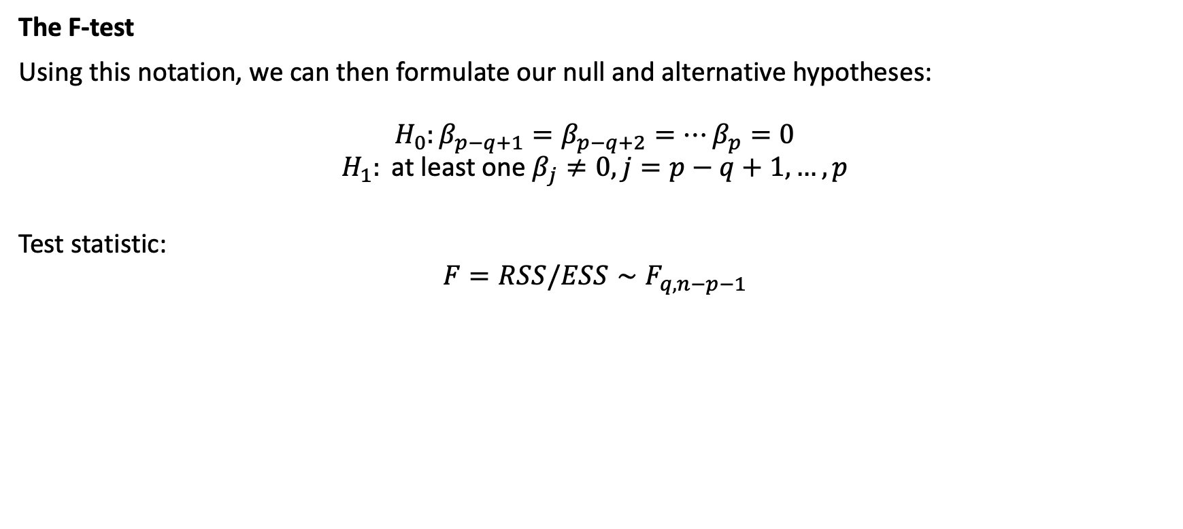
Inference for GLMs
The F-test
Using this notation, we can then formulate our null and alternative hypotheses:
$$H_{0}:β_{p−q+1}=β_{p−q+2}=…β_{p}=0$$
$$H_{1}: \text{at} \text{least} \text{one} β_{j}≠0,j=p−q+1,…,p$$
Test statistic:
$$F=RSS/ESS∼F_{q,n−p−1}$$

Slide 45
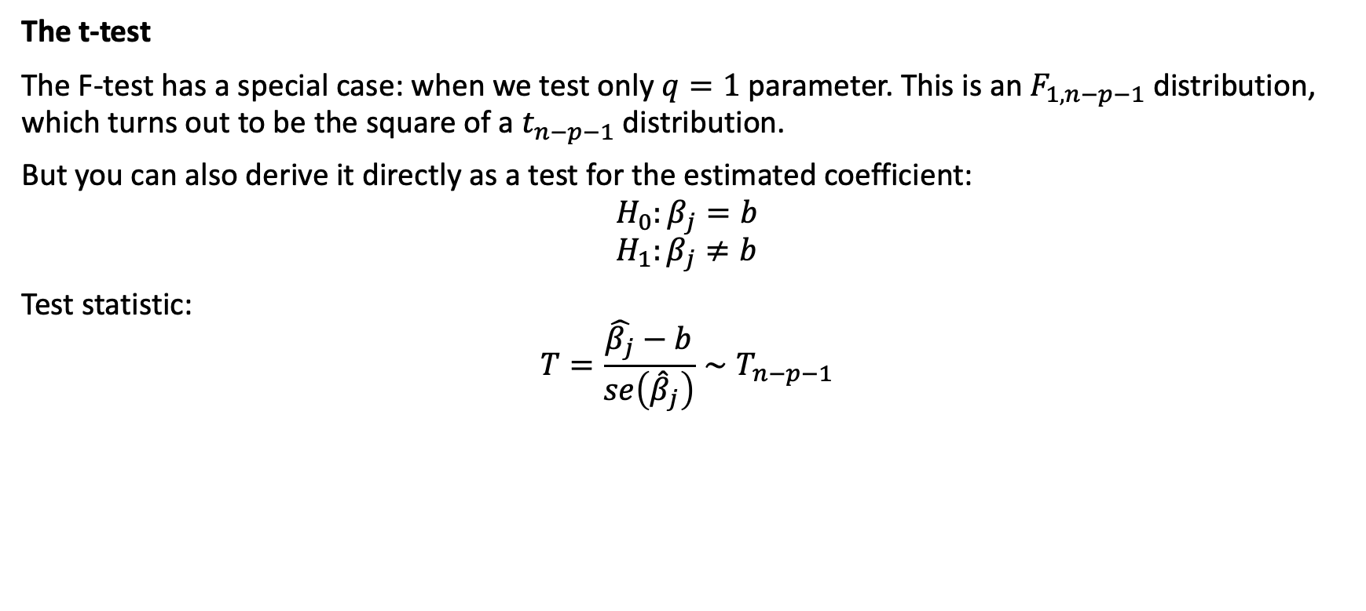
Inference for GLMs
The t-test
The F-test has a special case: when we test only $q=1$ parameter. This is an $F_{1,n−p−1}$ distribution, which turns out to be the square of a $t_{n−p−1}$ distribution.
But you can also derive it directly as a test for the estimated coefficient:
$$H_{0}:β_{j}=b$$
$$H_{1}:β_{j}≠b$$
Test statistic:
$$T=\frac{\hat{β_{j}}−b}{se\left({\hat{β}}_{j}\right)}∼T_{n−p−1}$$

Slide 46
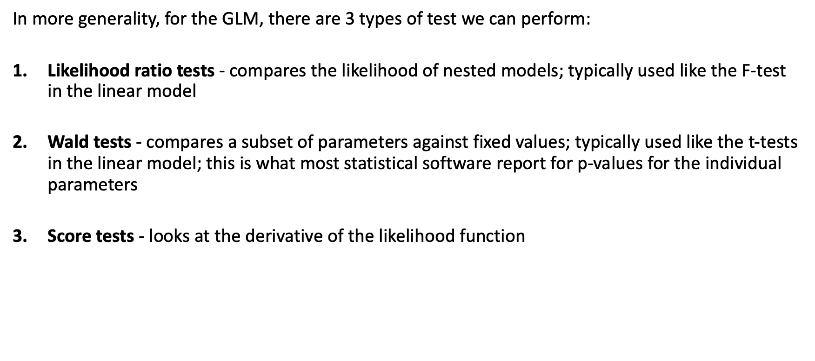
Inference for GLMs
In more generality, for the GLM, there are 3 types of test we can perform:
Likelihood ratio tests - compares the likelihood of nested models; typically used like the F-test in the linear model
Wald tests - compares a subset of parameters against fixed values; typically used like the t-tests in the linear model; this is what most statistical software report for p-values for the individual parameters
Score tests - looks at the derivative of the likelihood function

Slide 47
Inference for GLMs: confidence bands
Once we have fitted a GLM, we can predict new values.
Predicting response values for predictor values well outside the ones used to fit the model should be avoided!
Prediction uses estimates. Can we derive prediction confidence intervals? What we predict in a GLM is the mean response. We can actually consider 2 types of prediction confidence intervals:
for the mean response
for a new observation
The first one takes only the uncertainty of the model fit into account, the second one also takes the variability of the response values into account.
In this lecture we will only consider the first of these 2 types.

Slide 48
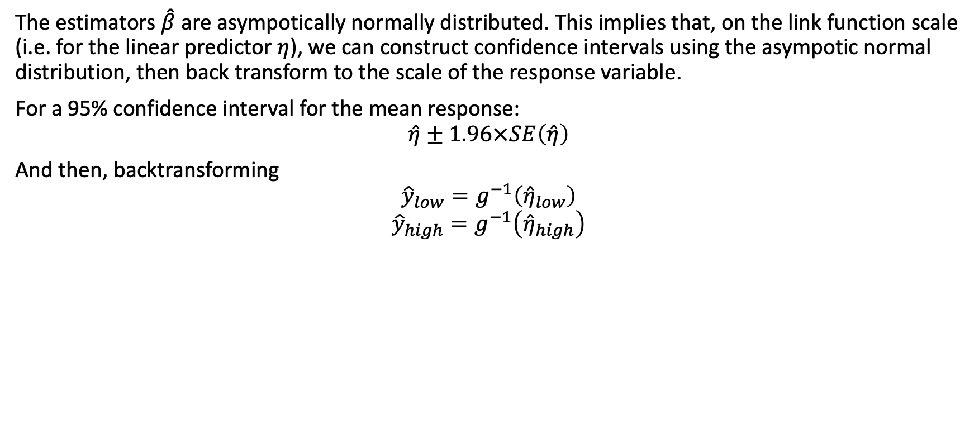
Inference for GLMs: confidence bands
The estimators $\hat{β}$ are asympotically normally distributed. This implies that, on the link function scale (i.e. for the linear predictor $η$), we can construct confidence intervals using the asympotic normal distribution, then back transform to the scale of the response variable.
For a 95% confidence interval for the mean response:
$$\hat{η}±1.96×SE\left(\hat{η}\right)$$
And then, backtransforming
$${\hat{y}}_{low}=g^{−1}\left({\hat{η}}_{low}\right)$$
$${\hat{y}}_{high}=g^{−1}\left({\hat{η}}_{high}\right)$$

Slide 49
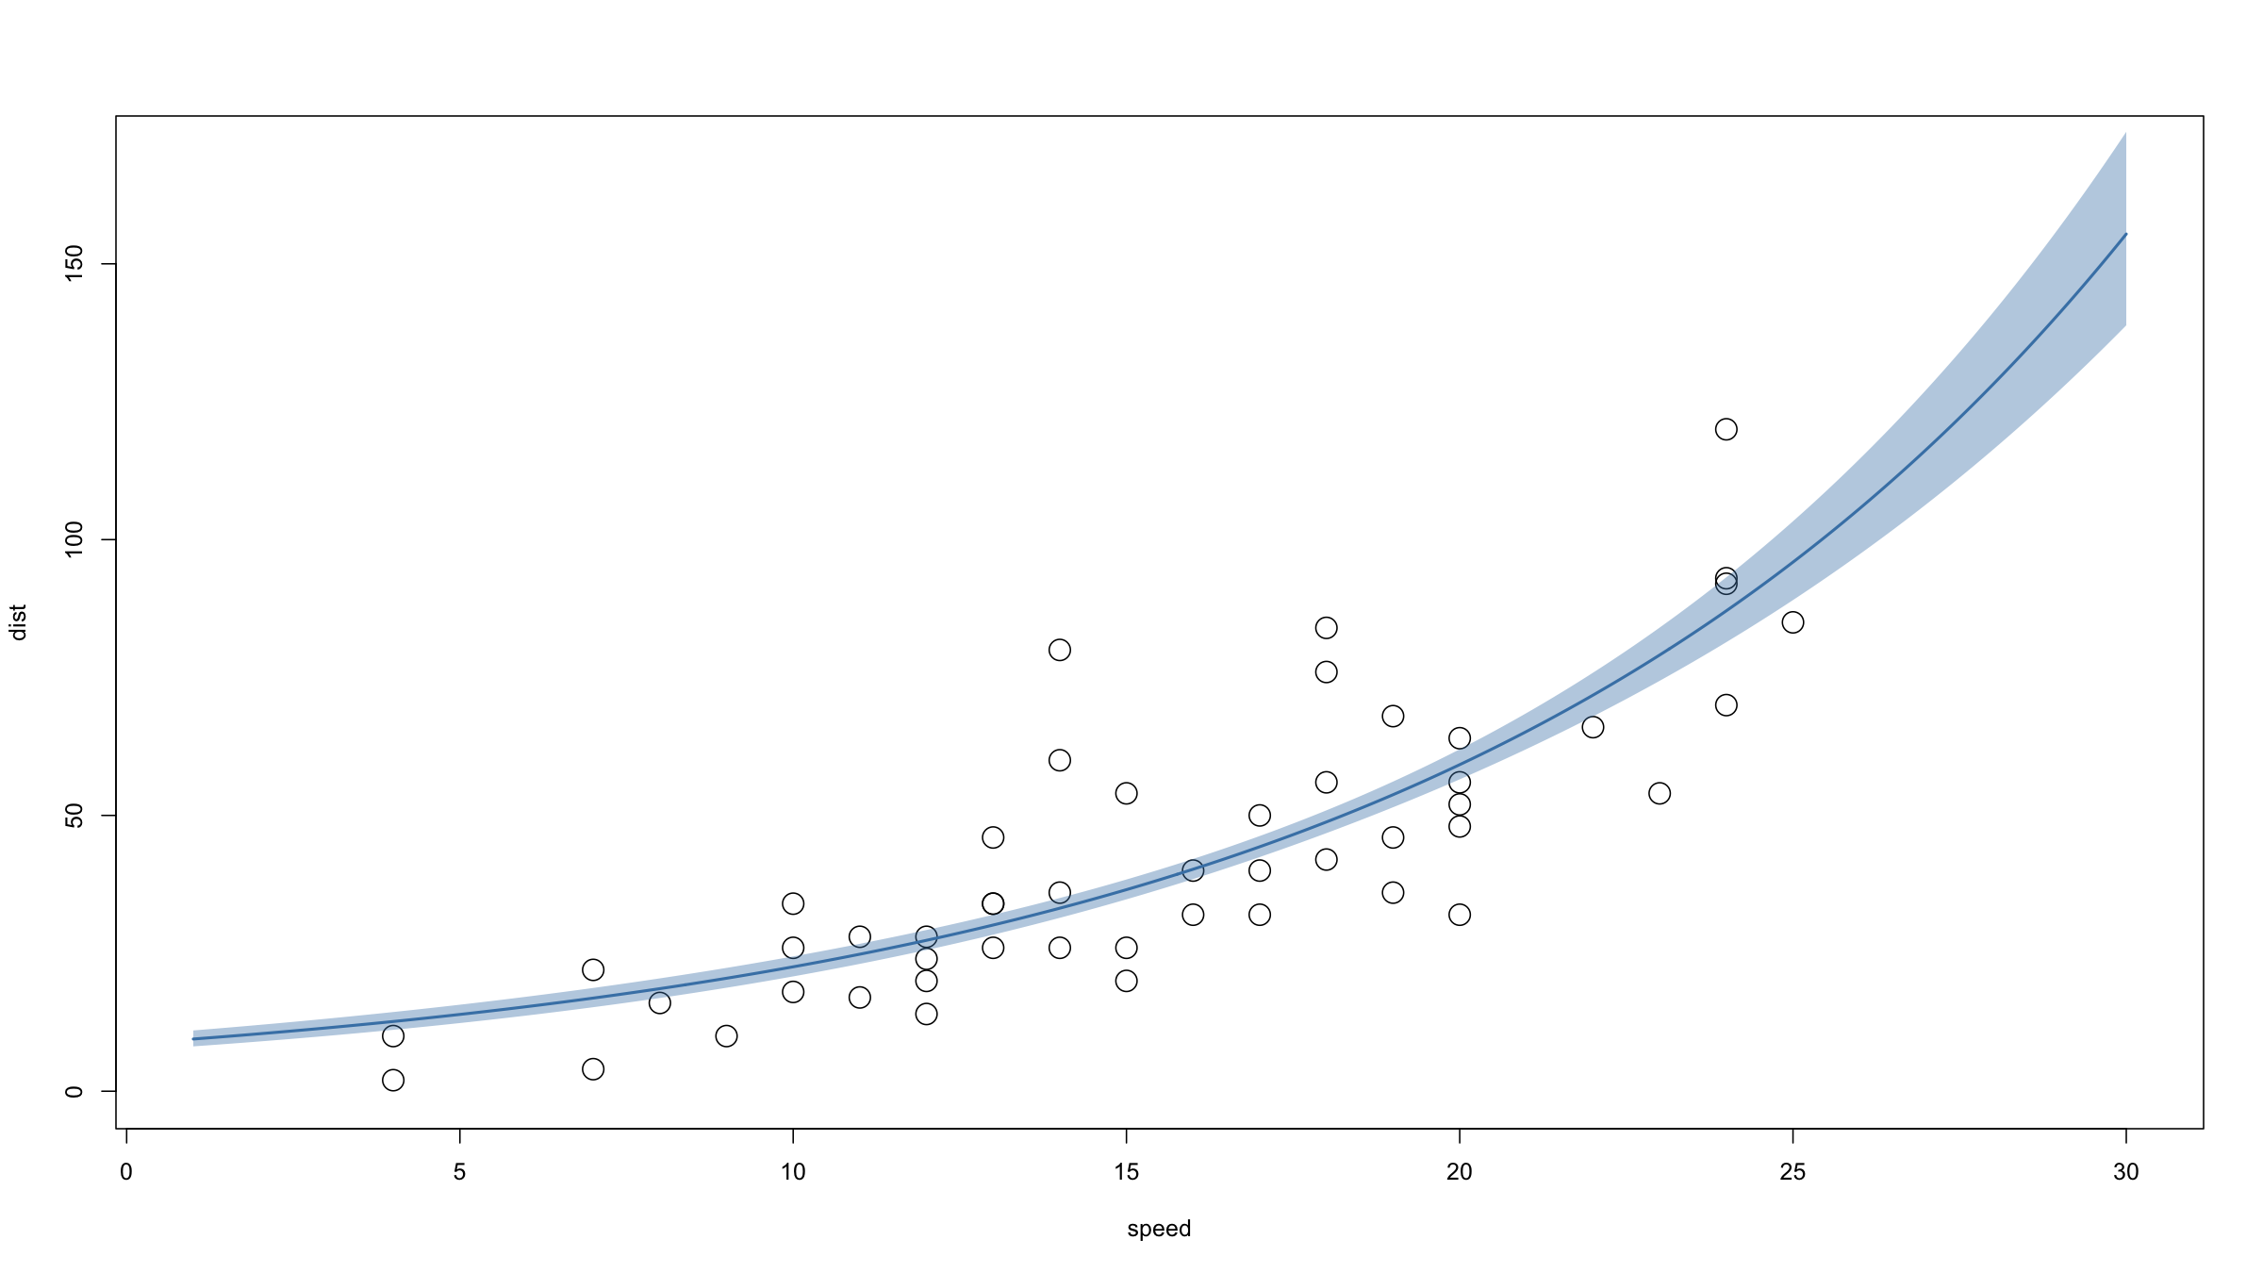
Inference for GLMs: confidence bands
Example:
modPois<-glm(dist~speed,data=cars,family=poisson) newX<-data.frame(speed=seq(1,30,length=500)) pred<-predict(modPois,type="link",newdata=newX, se.fit=T) predFit<-exp(pred$fit) predLow<-exp(pred$fit-qnorm(0.975)*pred$se.fit) predHigh<-exp(pred$fit+qnorm(0.975)*pred$se.fit) plot(dist~speed,data=cars,cex=2,xlim=c(1,30),ylim=c(0,170)) lines(newX$speed,predFit,lwd=2,col="steelblue") polygon(x=c(newX$speed,newX$speed[nrow(newX):1]),y=c(predLow,predHigh[nrow(newX):1]),col=rgb(70,130,180,alpha=100,maxColorValue=255),border=NA)

Slide 50
Non-identity link functions & non-normal distributions

Slide 51
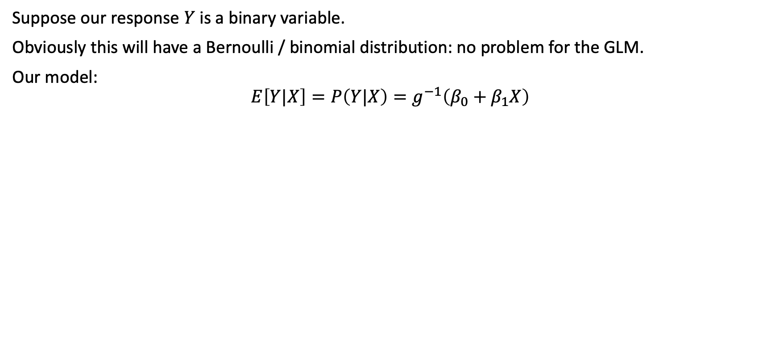
Beyond identity link and normal distribution
Suppose our response $Y$ is a binary variable.
Obviously this will have a Bernoulli / binomial distribution: no problem for the GLM.
Our model:
$$E\left[Y|X\right]=P\left(Y|X\right)=g^{−1}\left(β_{0}+β_{1}X\right)$$

Slide 52
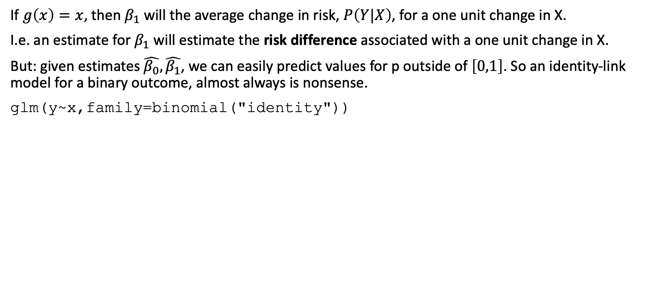
Beyond identity link and normal distribution
If $g\left(x\right)=x$, then $β_{1}$ will the average change in risk, $P\left(Y|X\right)$, for a one unit change in X.
I.e. an estimate for $β_{1}$ will estimate the risk difference associated with a one unit change in X.
But: given estimates $\hat{β_{0}},\hat{β_{1}}$, we can easily predict values for p outside of $\left[0,1\right]$. So an identity-link model for a binary outcome, almost always is nonsense.
glm(y~x,family=binomial("identity"))

Slide 53
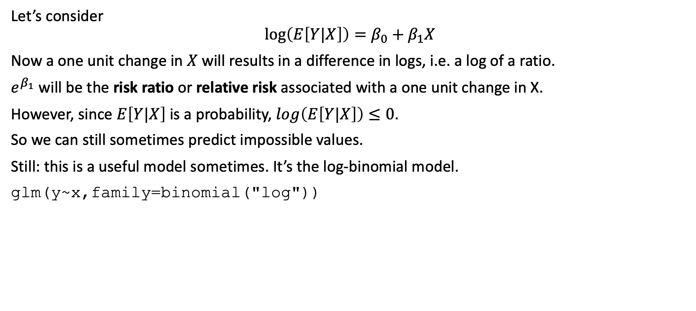
Beyond identity link and normal distribution
Let’s consider
$$log\left(E\left[Y|X\right]\right)=β_{0}+β_{1}X$$
Now a one unit change in $X$ will results in a difference in logs, i.e. a log of a ratio.
$e^{β_{1}}$ will be the risk ratio or relative risk associated with a one unit change in X.
However, since $E\left[Y|X\right]$ is a probability, $log\left(E\left[Y|X\right]\right)≤0$.
So we can still sometimes predict impossible values.
Still: this is a useful model sometimes. It’s the log-binomial model.
glm(y~x,family=binomial("log"))

Slide 54
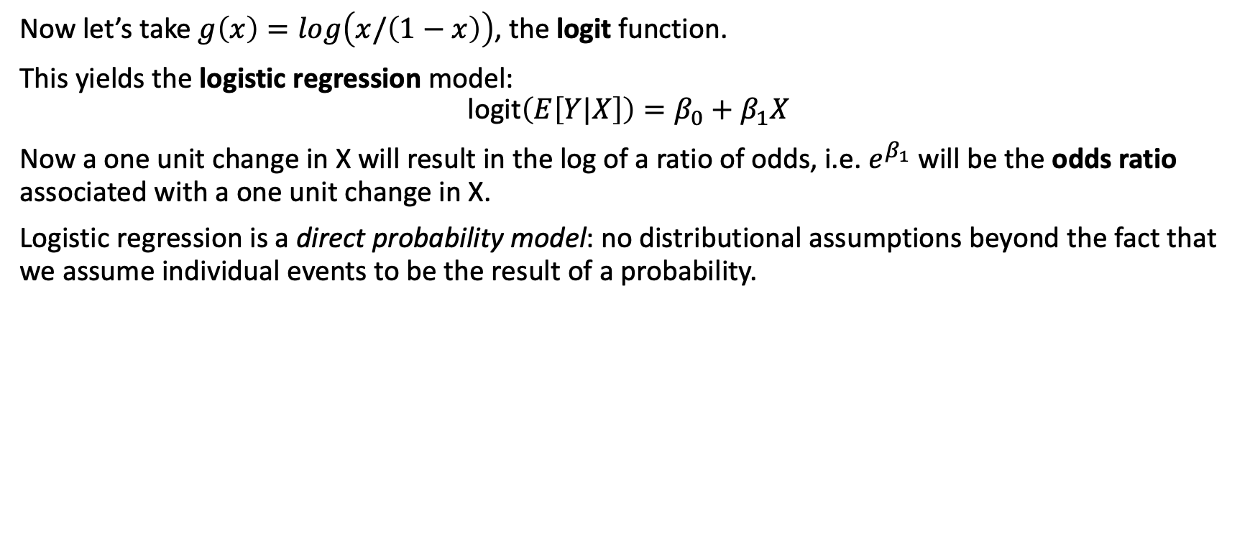
Beyond identity link and normal distribution
Now let’s take $g\left(x\right)=log\left(x/\left(1−x\right)\right)$, the logit function.
This yields the logistic regression model:
$$\text{logit}\left(E\left[Y|X\right]\right)=β_{0}+β_{1}X$$
Now a one unit change in X will result in the log of a ratio of odds, i.e. $e^{β_{1}}$ will be the odds ratio associated with a one unit change in X.
Logistic regression is a direct probability model: no distributional assumptions beyond the fact that we assume individual events to be the result of a probability.

Slide 55
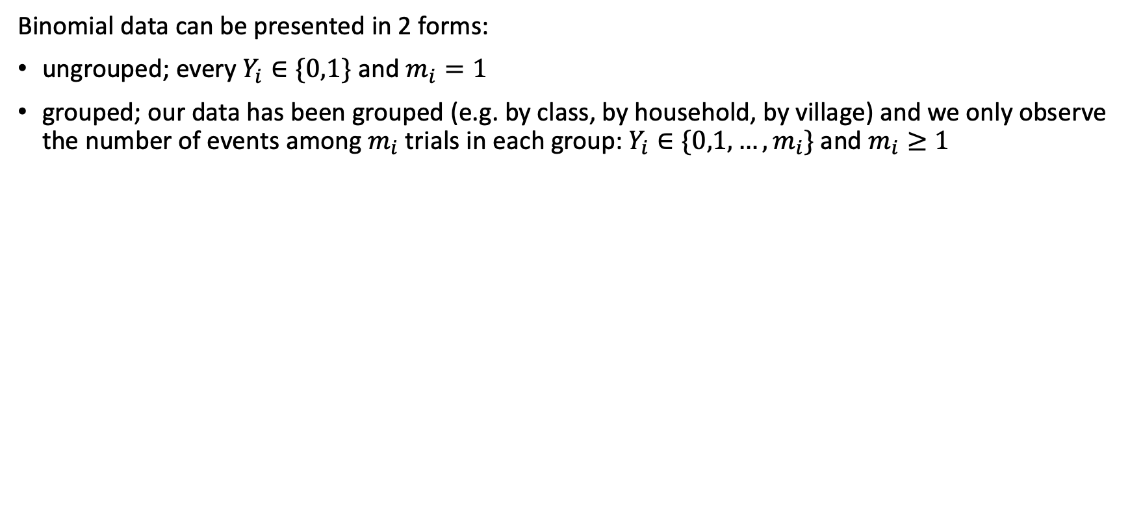
Beyond identity link and normal distribution
Binomial data can be presented in 2 forms:
ungrouped; every $Y_{i}∈\{0,1\}$ and $m_{i}=1$
grouped; our data has been grouped (e.g. by class, by household, by village) and we only observe the number of events among $m_{i}$ trials in each group: $Y_{i}∈\{0,1,…,m_{i}\}$ and $m_{i}≥1$

Slide 56
Beyond identity link and normal distribution
Example
# ungrouped modLowBirthWeight<-glm(lowbwt~Gestation,data=bw,family=binomial) # family=binomial("logit") also works summary(modLowBirthWeight)
Call: glm(formula = lowbwt ~ Gestation, family = binomial, data = bw) Coefficients: Estimate Std. Error z value Pr(>|z|) (Intercept) 31.3127 11.3145 2.767 0.00565 ** Gestation -0.8773 0.3046 -2.880 0.00398 ** --- Signif. codes: 0 '***' 0.001 '**' 0.01 '*' 0.05 '.' 0.1 ' ' 1 (Dispersion parameter for binomial family taken to be 1) Null deviance: 34.450 on 41 degrees of freedom Residual deviance: 18.025 on 40 degrees of freedom AIC: 22.025 Number of Fisher Scoring iterations: 6

Slide 57
Beyond identity link and normal distribution
Example
round(digits=2,cbind( exp(coef(modLowBirthWeight)), exp(confint(modLowBirthWeight)) ))
2.5 % 97.5 % (Intercept) 3.971124e+13 501487.34 1.146583e+26 Gestation 4.200000e-01 0.19 6.800000e-01

Slide 58
Beyond identity link and normal distribution
Example
# grouped modTitanic<-glm(cbind(survivors, dead) ~ class + age + sex + class*sex, data = titanic, family = binomial("logit")) summary(modTitanic) ## ## Call: ## glm(formula = cbind(survivors, dead) ~ class + age + sex + class * ## sex, family = binomial("logit"), data = titanic) ## ## Coefficients: ## Estimate Std. Error z value Pr(>|z|) ## (Intercept) 3.5579 0.5071 7.017 2.27e-12 *** ## class2nd -1.6806 0.5878 -2.859 0.00425 ** ## class3rd -3.8854 0.5287 -7.350 1.99e-13 *** ## classCrew -1.6608 0.8003 -2.075 0.03797 * ## ageChild 1.0537 0.2304 4.573 4.81e-06 *** ## sexMale -4.2331 0.5310 -7.972 1.56e-15 *** ## class2nd:sexMale 0.4483 0.6460 0.694 0.48772 ## class3rd:sexMale 2.8625 0.5633 5.082 3.73e-07 *** ## classCrew:sexMale 1.0862 0.8197 1.325 0.18516 ## --- ## Signif. codes: 0 '***' 0.001 '**' 0.01 '*' 0.05 '.' 0.1 ' ' 1 ## ## (Dispersion parameter for binomial family taken to be 1) ## ## Null deviance: 671.962 on 13 degrees of freedom ## Residual deviance: 45.899 on 5 degrees of freedom ## AIC: 110.52 ## ## Number of Fisher Scoring iterations: 5

Slide 59
Beyond identity link and normal distribution
Example
round(digits=2,cbind( exp(coef(modTitanic)), exp(confint(modTitanic)) )) ## 2.5 % 97.5 % ## (Intercept) 35.09 14.82 114.15 ## class2nd 0.19 0.05 0.55 ## class3rd 0.02 0.01 0.05 ## classCrew 0.19 0.04 1.02 ## ageChild 2.87 1.82 4.51 ## sexMale 0.01 0.00 0.04 ## class2nd:sexMale 1.57 0.47 6.24 ## class3rd:sexMale 17.51 6.44 61.76 ## classCrew:sexMale 2.96 0.53 14.95

Slide 60
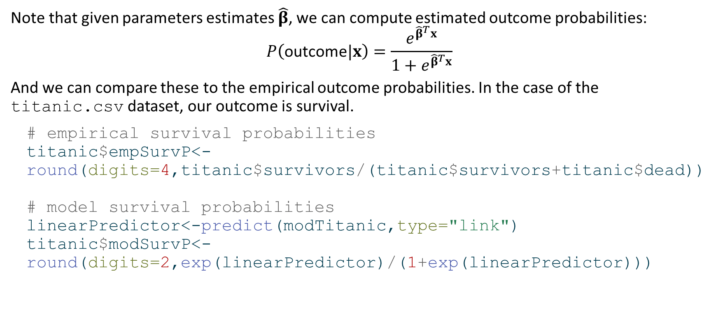
Beyond identity link and normal distribution
Note that given parameters estimates $\hat{β}$, we can compute estimated outcome probabilities:
$$P\left(\text{outcome}|x\right)=\frac{e^{{\hat{β}}^{T}x}}{1+e^{{\hat{β}}^{T}x}}$$
And we can compare these to the empirical outcome probabilities. In the case of the titanic.csv dataset, our outcome is survival.
# empirical survival probabilities titanic$empSurvP<-round(digits=4,titanic$survivors/(titanic$survivors+titanic$dead)) # model survival probabilities linearPredictor<-predict(modTitanic,type="link") titanic$modSurvP<-round(digits=2,exp(linearPredictor)/(1+exp(linearPredictor)))

Slide 61
Beyond identity link and normal distribution
print(titanic)
class age sex survivors dead empSurvP modSurvP 1 1st Adult Male 57 118 0.3257 0.34 2 2nd Adult Male 14 154 0.0833 0.13 3 3rd Adult Male 75 387 0.1623 0.15 4 Crew Adult Male 192 670 0.2227 0.22 5 1st Child Male 5 0 1.0000 0.59 6 2nd Child Male 11 0 1.0000 0.30 7 3rd Child Male 13 35 0.2708 0.34 8 1st Adult Female 140 4 0.9722 0.97 9 2nd Adult Female 80 13 0.8602 0.87 10 3rd Adult Female 76 89 0.4606 0.42 11 Crew Adult Female 20 3 0.8696 0.87 12 1st Child Female 1 0 1.0000 0.99 13 2nd Child Female 13 0 1.0000 0.95 14 3rd Child Female 14 17 0.4516 0.67

Slide 62
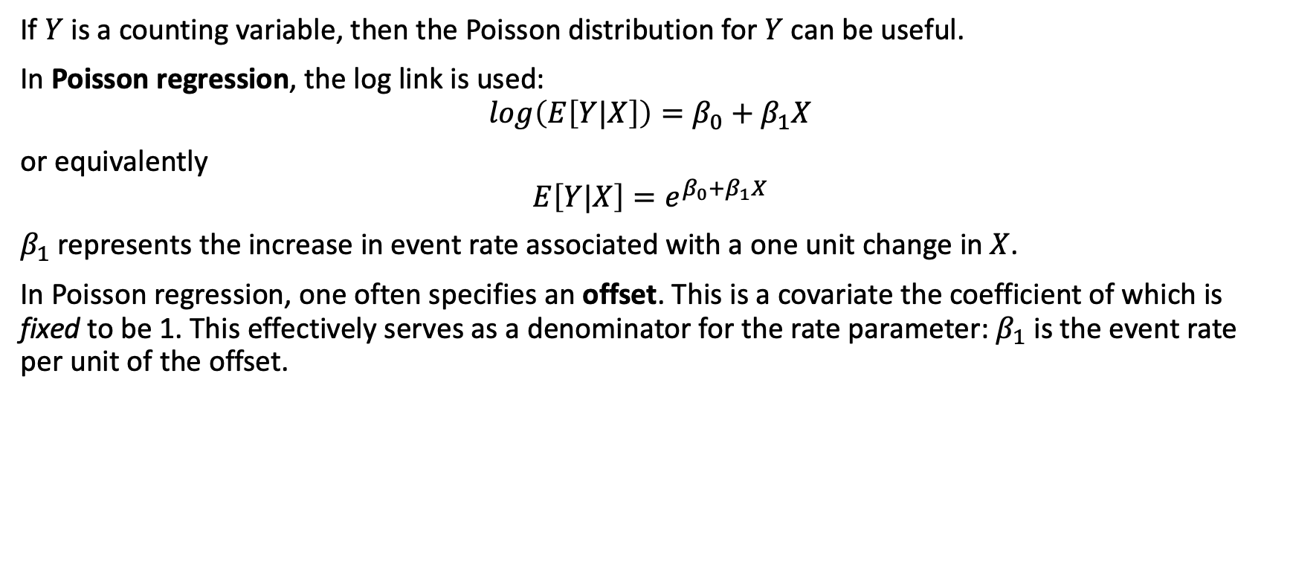
Beyond identity link and normal distribution
If $Y$ is a counting variable, then the Poisson distribution for $Y$ can be useful.
In Poisson regression, the log link is used:
$$log\left(E\left[Y|X\right]\right)=β_{0}+β_{1}X$$
or equivalently
$$E\left[Y|X\right]=e^{β_{0}+β_{1}X}$$
$β_{1}$ represents the increase in event rate associated with a one unit change in $X$.
In Poisson regression, one often specifies an offset. This is a covariate the coefficient of which is fixed to be 1. This effectively serves as a denominator for the rate parameter: $β_{1}$ is the event rate per unit of the offset.

Slide 63
Beyond identity link and normal distribution
Example
library(pscl) # install.packages("pscl") data(prussian) # data on deaths from horse kicks in the Prussian army (famous example of a Poisson process) modPrus<-glm(y~year+as.factor(corp),data=prussian,family=poisson) # family=poisson(link="log") also works

Slide 64
Model diagnostics

Slide 65
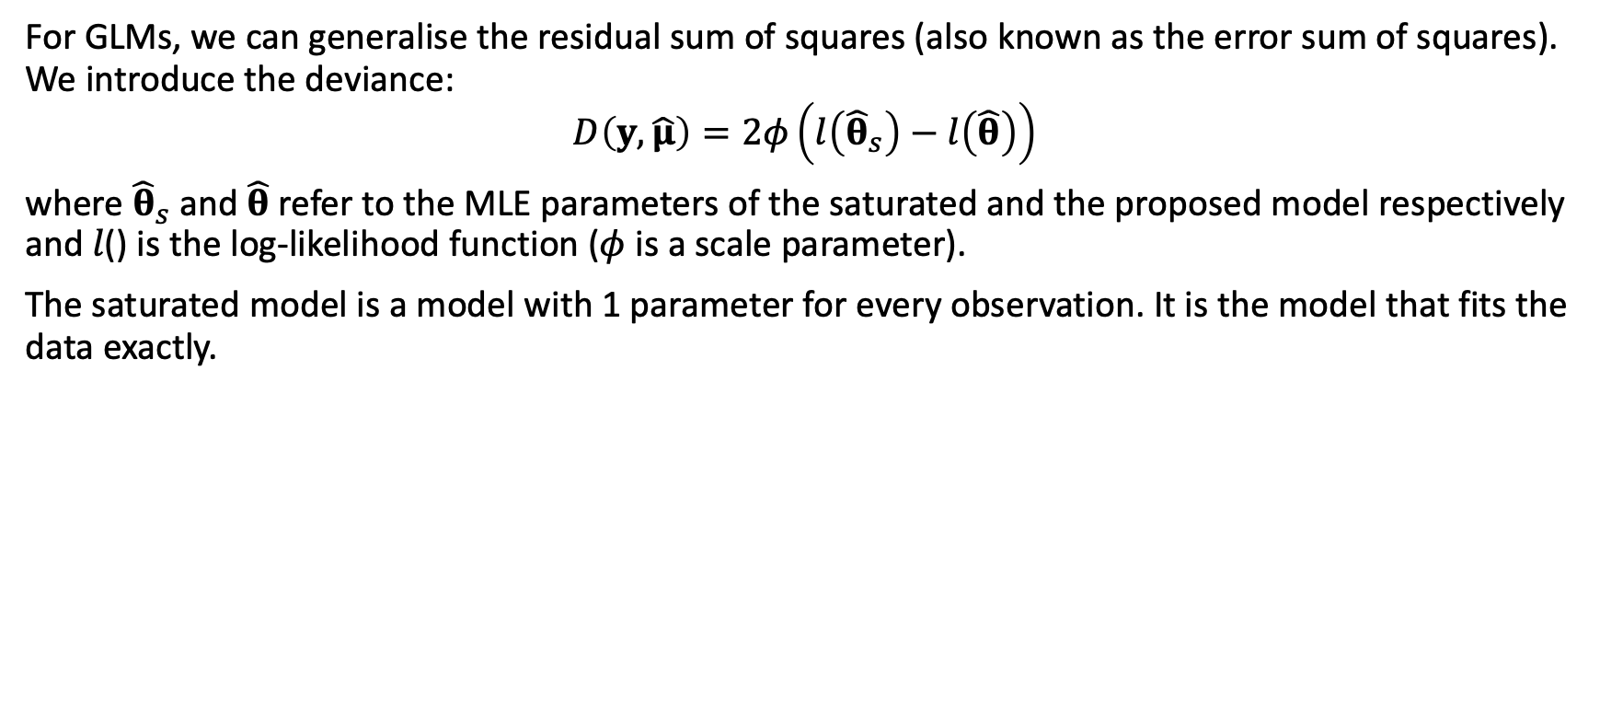
Diagnostics
For GLMs, we can generalise the residual sum of squares (also known as the error sum of squares). We introduce the deviance:
$$D\left(y,\hat{μ}\right)=2φ\left(l\left({\hat{θ}}_{s}\right)−l\left(\hat{θ}\right)\right)$$
where ${\hat{θ}}_{s}$ and $\hat{θ}$ refer to the MLE parameters of the saturated and the proposed model respectively and 𝑙() is the log-likelihood function ($φ$ is a scale parameter).
The saturated model is a model with 1 parameter for every observation. It is the model that fits the data exactly.

Slide 66

Diagnostics
The deviance is a scaled likelihood ratio statistic (recall: differences of logs = log of ratio).
As we saw, the deviance generalises the residual / error sum of squares to GLMs. This means the deviance can be used as a measure of goodness-of-fit.
Under the null hypothesis of no difference between the saturated and the proposed model:
$$D\left(y,\hat{μ}\right)∼χ_{n−p−1}^{2}$$
Question:
Why is it useful to test the null hypothesis that the fitted model is not meaningfully different from the saturated model?

Slide 67

Diagnostics
We can also compute the deviance for the worst model: the one where we include only an intercept.
This is called the null deviance and in the general linear model it is equal to the total sum of squares $TSS=SS_{y}$.
$$D_{0}\left(y\right)=D\left(y,\overset{‾}{y}\right)=2φ\left(l\left({\hat{θ}}_{s}\right)−l\left({\hat{θ}}_{0}\right)\right)$$
The more the deviance (for the proposed model) is different from the null deviance (for the empty model), the more variation is explained by the fitted model (i.e. the better a fit it is).
The smaller the deviance, the better the fit.
In R output, the deviance is referred to as residual deviance.

Slide 68

Diagnostics
Residuals
We can calculate several different types of residulals in a GLM:
response $r_{i}=y_{i}−{\hat{y}}_{i}$
working $r_{i}^{W}$ obtained from the last iteration of the IWLS algorithm
Pearson response residuals standardised by the variance function $r_{i}^{P}=\frac{y_{i}−{\hat{y}}_{i}}{\sqrt{V\left({\hat{μ}}_{i}\right)}}$
deviance $r_{i}^{D}$ so that $\sum_{i}^{​}{{\left(r_{i}^{D}\right)}^{2}}=D\left(y,\hat{μ}\right)$

Slide 69

Diagnostics
Residuals
Note: for normal models these are all equal.
R will by default return deviance residuals (e.g.by typing resid(mod)). You can use the same R function to compute the other residuals: resid(mod,type="pearson") will compute the Pearson residuals.

Slide 70
Diagnostics
Model diagnostics: why do it?
There is a very simple & good reason: if the data violate the model assumptions, then all the inferential results we derived (coverage of CIs, p-values, …) no longer hold – we cannot really say anything about the process that generated the data from our model and the model predictions are likely to be very wrong.
The point of model diagnostics is to check that the model assumptions appear to be met.
There are several checks that can be done. For each check, We will first discuss the case of the general linear model, then move on to generalised linear models.

Slide 71

Diagnostics
Let’s fit a linear model to the TB data:
modBW_Mppwt<-glm(Birthweight~mppwt,data=bw) modBW_GestMppwt<-glm(Birthweight~Gestation+mppwt,data=bw)

Slide 72

Diagnostics
You have fitted a GLM model. How do you know it’s any good?
Goodness of fit?
Visual check
$R^{2}$, $R_{adj}^{2}$
AIC, BIC
Residuals?
QQ plot
Residuals vs. predicted values
Hat values, Cook’s distance

Slide 73

Diagnostics
Goodness of fit
Visual checks
These work well for simple models with only one or a limited number of predictors.
Conceptually simple: just plot response vs. prdictor and add a line for the model fit.
Same for general & generalised linear models.
ggplot(data=bw,mapping=aes(x=mppwt,y=Birthweight)) + geom_point() + geom_abline(intercept=coef(modBW_Mppwt)[1], slope=coef(modBW_Mppwt)[2], col="steelblue", lwd=2) + xlab("mother's pre-pregnancy weight (lbs)") + ylab("neonate birthweight (lbs)")

Slide 74


Diagnostics
Goodness of fit
Same thing…
ggplot(data=bw,mapping=aes(x=mppwt,y=Birthweight)) + geom_point()+ geom_smooth(method="lm")

Slide 75

Diagnostics
Goodness of fit
We have already seen $R^{2}$, the coefficient of determination. It can be interpreted as the proportion of variance explained by the model.
It is not wise to maximise $R^{2}$: you will end up with overfitted models with many parameters.
The adjusted $R^{2}$,
$$R_{adj}^{2}=1−\left(1−R^{2}\right)\frac{n−1}{n−p−1}$$
is penalised for the number of parameters in the model.

Slide 76

Diagnostics
Goodness of fit
For GLMs we need to generalise $R^{2}$ however. We can compute the proportion of deviance explained, the pseudo $R^{2}$:
$$R_{d}^{2}=1−\frac{D\left(y,\hat{μ}\right)}{D_{0}\left(y\right)}$$
Intuitively, you are checking how much of the null deviance is explained by your model.
As for the standard $R^{2}$, if you select your model based on $R_{d}^{2}$, you will overfit, so use the adjusted $R_{d,adj}^{2}$.

Slide 77

Diagnostics
Goodness of fit
When maximum likelihood is used, you can also consider the likelihood itself as a measure of (relative) goodness of fit.
Again: better to penalise for the number of parameters in the model.
Akaike Information Criterion (AIC)
$$2⋅\left(p+1\right)−2⋅\text{ln}\left(\hat{L}\right)$$
Bayesian Information Criterion (BIC)
$$\text{ln}\text{(}\text{n}\text{)}⋅\left(p+1\right)−2⋅\text{ln}\left(\hat{L}\right)$$
This works also for GLMs.

Slide 78

Diagnostics
QQ plot
Plots the empirical quantiles of the residuals against those from a normal distribution. If the residuals are normally distributed, these should line on a straight line.
rmodBW<-residuals(modBW_Mppwt) theoQ<-qnorm(order(order(rmodBW))/length(rmodBW)) # calculates theorectical normal quantiles plot(theoQ,rmodBW, xlab="theoretical normal quantiles", ylab="sample quantiles", main="QQ plot") qqline(rmodBW) # just adds the line

Slide 79

Diagnostics
QQ plot
This would also work:
qqnorm(rmodBW, xlab="theoretical normal quantiles", ylab="sample quantiles", main="QQ plot") qqline(rmodBW)

Slide 80
Diagnostics
QQ plot
QQ plots show the empirical quantiles of the residuals against those from the theoretical distribution of the errors.
For Gaussian response models, the theoretical distribution is just the normal distribution. For other response distributions, this can be a bit trickier and simulations may be needed needed to derive approximate theoretical quantiles.
We know that the linear predictor estimates are approximately normally distributed, so we could compute residuals on that scale and then do a normal distribution QQ plot. However even this has its limitations.

Slide 81
Diagnostics
QQ plot
Further, models like logistic regression are direct probability models and hence there are no distributional assumptions for the errors.
For these reasons, in GLMs, as opposed to normal distribution linear models, QQ plots are not often used.

Slide 82


Diagnostics
Residuals vs. predicted values
You can easily (though subjectively) verify whether:
residuals centered symmetrically around 0
residuals have constant variance
there are any outliers
plot(predict(modBW_Mppwt,data=bw),residuals(modBW_Mppwt), xlab="fitted values", ylab="residuals")

Slide 83
Diagnostics
Residuals vs. predicted values
For non-normal distribution GLMs, the variance function of the model can imply a trend of the variance with the mean.
For this reason, Pearson residuals are very useful in GLMs: these residuals are standardised by the estimated variance function. In other words, if the Pearson residuals exhibit non-constant variance, then this suggest we have misspecified the data distribution.

Slide 84


Diagnostics
Typing plot(modBW_Mppwt) will produce these and a few more (we have not the time to cover everything here) diagnostic graphs.
plot(modBW_Mppwt)

Slide 85


Slide 86


Slide 87


Slide 88
Diagnostics
Influential observations
An influential observation is an observation which, if dropped from the dataset when fitting the model, would noticeably affect the model parameter estimates.
We have already alluded to one type of such influential observations: observations with high leverage - large residuals near the extremes of the predictor variables’ ranges.
There are many methods, most based on re-fitting models while leaving out individual observations. We will focus on 2 metrics: hat values (measuring leverage of observations) and Cook’s distance (measuring influence).

Slide 89

Diagnostics
Influential observations
The hat matrix $H$ is the matrix that projects $y$ onto the subspace spanned by the columns of the design matrix $X$: $\hat{y}=Hy$. In the normal distribution linear model:
$$H=X{\left(X^{T}X\right)}^{−1}X^{T}$$
and in GLMs:
$$H=W^{1/2}X{\left(X^{T}WX\right)}^{−1}X^{T}W^{1/2}$$
The hat values $h_{ii}$ are the diagonal elements of this matrix and they indicate the leverage of observations.

Slide 90


Diagnostics
Influential observations
The $h_{ii}$ are bounded between 0 and 1 (in models with an intercept, they are bounded between 1/n and 1), and their sum, $\sum_{i}^{​}{h_{ii}}$, is always equal to $p+1$, the number of coefficients in the model, including the intercept. Problems in which there are a few very large $h_{ii}$ can be troublesome: in particular, large-sample normality of some linear combinations of the regressors is likely to fail, and high-leverage observations may exert undue influence on the results.
The R function hatvalues() will compute hat values for both lm and glm objects.
plot(hatvalues(modBW_Mppwt),cex=2)

Slide 91

Diagnostics
Influential observations
The most common influence measure is Cook’s distance. It is one of many leave-one-out / deletion methods for measuring influence of observations.
If $\hat{β}$ is the estimated coefficient vector from the full dataset, then let ${\hat{β}}_{\left(i\right)}$ be the vector of coefficient estimates obtained from fitting the model to the dataset with the $i^{th}$ observation removed.
The difference $\hat{β}−{\hat{β}}_{\left(i\right)}$ directly measures the influence of the $i^{th}$ observation: small / large difference = small / large influence.

Slide 92

Diagnostics
Influential observations
This difference is a vector however, and it is more convenient to summarise the influence by a single number.
Cook’s distance is the weighted sum of squares of the differences between the individual vector elements. In matrix notation:
$$D_{i}=\frac{{\left(β−{\hat{β}}_{\left(i\right)}\right)}^{T}{\left(X^{T}WX\right)}^{−1}\left(β−{\hat{β}}_{\left(i\right)}\right)}{\left(p+1\right)s^{2}}$$

Slide 93


Diagnostics
Influential observations
The R function cooks.distance() computes Cook’s distance for both lm and glm objects.
plot(cooks.distance(modBW_Mppwt),cex=2)

Slide 94

Diagnostics
Influential observations
The R package car has a helpful plotting function for plotting both the hat values and Cook’s D (and also studentised residuals). Cook’s D is given by the size of the circles.
library(car) influencePlot(modBW_Mppwt)

Slide 95
StudRes Hat CookD 2 -2.1771480 0.05129374 0.11718176 4 -2.3575737 0.02388058 0.06103449 18 -0.1834157 0.21227697 0.00464508 37 1.5738906 0.10041359 0.13332758 40 2.3845565 0.02388058 0.06226080

Slide 96
GLM notes

Slide 97

Notes: Interaction terms
Consider the model
$$Y=β_{0}+β_{1} \text{age}+β_{2} \text{male}+β_{3} \text{male}⋅ \text{age}+ε$$
If you are female, the effect on $Y$ for age is $β_{1}$.
If you are male, the effect on $Y$ for age is $β_{1}+β_{3}$.
This is an interaction effect: age and sex are not independent. There are different slopes for age, depending on your sex.
You can have interaction terms for 2 categorical variables, 1 categorical & 1 continuous, 2 continuous variables.
Interpretation becomes more difficult.
Always include both individual terms!

Slide 98
Notes: Interaction terms
Example
ado<-read.csv("dataAndSupportDocs/adolescent_small.csv") modWeightInt<-glm(a104wt~a12age*hiv,data=ado) summary(modWeightInt)$coefficients
Estimate Std. Error t value Pr(>|t|) (Intercept) -12.202112 3.3080393 -3.688624 2.741478e-04 a12age 3.895924 0.2359772 16.509745 1.844004e-42 hivpositive 9.074343 5.1781378 1.752434 8.086903e-02 a12age:hivpositive -1.453828 0.3808874 -3.816950 1.686588e-04

Slide 99

Notes: Collinearity
If two predictors $X_{1},X_{2}$ are correlated, then estimation of the GLM can become difficult and interpretation of coefficients also becomes tricky.
The numerical instability comes from the fact that MLE will involve matrix inversion and this will become singular the more $X_{1}$ and $X_{2}$ are correlated.
Centering correlated variables will often help.
Best to avoid including collinear predictors.
Variance inflation factors (VIF) can help to spot multicollinearity and to remove problematic explanatory variables.

Slide 100

Notes: Collinearity
Consider the model:
$$Y=β_{0}+β_{1}X_{1}+β_{2}X_{2}+…+β_{k}X_{k}+ε \left(∗\right)$$
The VIF for the $j^{th}$ predictor variable is given by $VIF_{j}=1/\left(1−R_{j}^{2}\right)$ where $R_{j}^{2}$ is the coefficient of determination of the model where $X_{j}$ is the response and all other explanatory variables in the model (*) are predictors.
If the $j^{t}h$ variable is independent of all other variables, then $R_{j}^{2}=0$ and $VIF_{j}=1$.
In practice (rule of thumb): $VIF>10$ = severe collinearity, $VIF>5$ = high collinearity.

Slide 101
Notes: Collinearity
In R: car::vif computes VIFs, but the function Hmisc::varclus can also be helpful.
ado$tmpVar<-ado$a103ht+rnorm(nrow(ado),sd=6) modWeightColl<-glm(a104wt~as.factor(a13sex)+a12age+a103ht+tmpVar,data=ado) car::vif(modWeightColl)
as.factor(a13sex) a12age a103ht tmpVar 1.019925 2.183195 7.359766 6.172828

Slide 102

Notes: Variable & functional form selection
How to select variables for inclusion in a model?
This is not as trivial as it sounds. It is best to rely on expert knowledge and avoiding methods that are based on estimated effects / p-values such as
significant variables from single predictor regressions [the worst selection technique]
stepwise forwards selection
stepwise backwards selection [least bad as it involves at least a full model fot]
These methods are used (very) commonly, especially forwards selection, but violate many principles of statistical estimation and hypothesis testing.

Slide 103

Notes: Variable & functional form selection
The problems with these techniques (see Harrell, F., Regression Modelling Strategies, 2nd ed., 2015, Springer.):
Yield $R^{2}$ values that are biased high.
Ordinary F and $χ^{2}$ tests do not have the claimed distributions.
Standard errors of regression coefficients are biased low.
Resulting p-values are too small.
Regression coefficients are biased high.
Residual confounding is an issue.
Collinearity is not solved but exarcerbated by these techniques.

Slide 104
Notes: Variable & functional form selection
If you choose variables to keep in the model by their p-values, then use a high threshold, e.g. 0.5.
The best approach is to discuss a priori with experts in the field in which the data have been collected and ask them what should be included in the model. Then base your inference only on that single model you fitted. Keep variables even if they have non-significant coefficients. E.g. predictions can still benefit from non-significant variables in the model.
Regularisation techniques such as elastic net, ridge regression or the lasso have more desirable properties (but do not get around all problems). These methods put a penalty on the coefficients in the model and this either shrinks (ridge, L2 penalty) them or removes (lasso, L1 penalty) them from the model as the penalty is increased.

Slide 105

Notes: Variable & functional form selection
Most relationships between variables are not linear.
Categorisation of a continuous predictor is often used to deal with such non-linearity. However, this is inefficient and leads to reduced power.
Transformations or polynomial terms ($X^{2}$, $X^{3}$ etc) can be used, but polynomials in particular have undesirable properties (peaks & valleys, points far away can have a large impact on the curve in another region, …).
Linear or cubic splines and Generalised Additive Models (GAMs) can provide very flexible ways to model data while still providing all the statistical inference machinery we have seen for GLMs.
geom_smooth() from ggplot2 uses GAMs for more than 1,000 observations (or when method="gam" is specified).

Slide 106


Notes: Variable & functional form selection
A draftman’s spline is a flexible strip of wood or rubber to draw smooth curves (e.g. used by shipbuilders).
Mathematically, for a response $y$ and a predictor $x$, a linear spline with $k=3$ knots at locations $x=k_{1},k_{2},k_{3}$ can be written as:
$$y=β_{0}+β_{1}⋅x+β_{2}⋅{\left(x−k_{1}\right)}_{+}+β_{3}⋅{\left(x−k_{2}\right)}_{+}+β_{4}⋅{\left(x−k_{3}\right)}_{+}+ε$$
where ${\left(x\right)}_{+}=x$ if $x≥0$ and $0$ otherwise.
This means that the fitted curve has different slopes in different intervals of values of $x$:

Slide 107
Notes: Variable & functional form selection
x<-rnorm(100,mean=5,sd=2) y<-2+x-2*x^2+0.2*x^3+rnorm(100,sd=5) df<-data.frame(x,y) rm(x,y) modLsp<-glm(y~lsp(x,c(3,6)),data=df) # lsp() requires rms package newdf<-data.frame(x=df$x,predict.lm(modLsp,interval="confidence"))

Slide 108

Notes: Variable & functional form selection
df %>% ggplot(mapping=aes(x=x,y=y)) + geom_point(size=3) + geom_line(data=newdf,mapping=aes(x=x,y=fit),col="orange",lwd=2) + geom_ribbon(data=newdf,mapping=aes(y=fit,ymin=lwr,ymax=upr),alpha=0.2) + geom_vline(xintercept=3,lty=2,col="darkgrey") + geom_vline(xintercept=6,lty=2,col="darkgrey")

Slide 109

Notes: Variable & functional form selection
Linear splines are not smooth and therefore cubic splines are often preferred.
Cubic splines can be poorly behaved in the tails (outside of the most extreme knots). To avoid this, they can be forced t be linear in the tails. Such splines are called restricted cubic splines.
modRcs<-glm(y~rcs(x,nk=3),data=df) # rcs requires rms package newdf<-data.frame(x=df$x,predict.lm(modRcs,interval="confidence"))
df %>% ggplot(mapping=aes(x=x,y=y)) + geom_point() + geom_line(col="orange",lwd=2,mapping=aes(x=x,y=predict(modRcs))) + geom_line(data=newdf,mapping=aes(x=x,y=fit),col="orange",lwd=2) + geom_ribbon(data=newdf,mapping=aes(y=fit,ymin=lwr,ymax=upr),alpha=0.2)

Slide 110

Notes: Variable & functional form selection
Where the knots should be is not an easy problem. Adding them as model parameters to be estimated can lead to unstable parameter estimates and to standard estimation algorithms not being usable.
Luckily for cubic splines, the position of knots matters less than the number of knots. Knots are therefore often placed at regular intervals or quantiles of the continuous predictor.
Besides splines, fractional polynomials can also be used for more flexible regression curves. See https://doi.org/10.1186/s41512-020-00074-3 for a much more comprehensive discussion of functional form selection.

Slide 111

Notes: Correlated data
If your observations $y_{i}$ are not independent because of correlations, e.g. clustering of children within teachers within schools, or longitudinal data with multiple observations for the same individual, we cannot use the GLM.
Marginal models: General Estimating Equations (GEE)
library(gee)
Mixed models: [Generalised] Linear Mixed Models ([G]LMM)
library(nlme) library(lme4)

Slide 112

Notes: rms package
The rms package provides a full set of tools for all kinds of regression problems.

Slide 113

[end of Session 5]

